Slide 1



3-DAY INTENSIVE COURSE
Synthetic Data Generation
using Generative AI
Theory and hands-on practice, grounded in the peer-reviewed literature
Presenting for
Vel Tech Rangarajan Dr. Sagunthala
R&D Institute of Science and Technology, Chennai
8–10 October 2026
Dr. V.K.R. Rajeswari Satuluri
Chief Innovation Officer,
Stixis AI Solutions Private Limited.
477, Urban Vault, 18th Cross Road, Parangipalya, Sector-2,
HSR Layout, Bangalore-560102. KARNATAKA, INDIA

Slide 2
COURSE MAP
Three days, fifteen hours, one delivery pipeline
Day | Theme | Theory topics covered | Lab (2 h)
Day 1 | Foundations of synthetic data + generative AI | Introduction · Real vs synthetic · Why organisations use it · Types · Applications · Introduction to generative AI · Model overview · Core architectures · Choosing an approach | Profiling a Glixify-inspired wearable + CGM dataset (simplified teaching dataset) and generating a first synthetic copy
Day 2 | Synthetic data generation techniques | Tabular · Text · Images · Choosing and training a generator (GAN, VAE, diffusion) · Inspecting the output | Training CTGAN on a shared dataset and inspecting its output; TVAE and TabDDPM shown as instructor demos
Day 3 | Quality, validation, privacy & industry applications | Synthetic data quality · Privacy · Illustrative Stixis-style use case | Building a three-gate evaluation scorecard and a privacy audit

Slide 3



www.glixify.ai
Glixify Wellness Pioneers Program
July - 2026

Slide 4
What is
Glixify
Continuous Monitoring
Integrates with CGMs and wearable devices.
Track What Matters
Tracks health data such as glucose levels, activity, stress, spo2, heart rate, and sleep
Glixify is a digital health platform focused on Type 2 diabetes prevention, management, and reversal/remission using a combination of Al, continuous monitoring, behavioral coaching, and clinical interventions.
Al-Powered Insights
Personalized insights, smart alerts & actionable nudges.
Human Coaching
Combines technology with human interventions and clinical guidance.
Lasting Transformation
Focuses on long-term lifestyle transformation rather than only symptom management.
Integrates with
Continuous Glucose
Monitors (CGMs) and wearable devices.
Tracks health data
such as glucose levels, activity, stress, spo2, heart rate, and sleep.
Combines technology with human interventions and and clinical guidance.
Focuses on long-term lifestyle transformation rather than only symptom management.
Your health. Our technology. Better tomorrow.
Monitor
Understand
Act
Transform

Slide 5
OBJECTIVES
What you will be able to do on Friday afternoon
Explain
Build
Validate
Define synthetic data precisely, distinguish it from anonymised and augmented data, and state where each generative family fits [1] [2] [7].
Choose a generative approach for tabular, text or image data, train a CTGAN, and inspect the synthetic output against business rules; VAE and diffusion models are demonstrated [5] [11] [12].
Run a three-gate fidelity–utility–privacy audit and defend a release decision with numbers rather than impressions [27] [30].
The through-line of the course
Synthetic data is only useful if it is simultaneously realistic enough to be informative, useful enough to train a model that works on real data, and private enough to release. These three requirements pull against each other, and every design decision in the next three days is a trade between them [27] [30].
Sources: [1] [2] [5] [7] [11] [12] [27] [30]

Slide 6

DAY 1
Foundations of Synthetic Data + Generative AI
From what synthetic data is, to which generative family you should reach for first.
1
2
3
4
5
6
7
8
9
Introduction to synthetic data
Real vs synthetic data
Why organisations use it
Types of synthetic data
Applications
Introduction to generative AI
Generative models overview
Core architectures
When to use which approach
Theory 3 hours · Hands-on lab 2 hours

Slide 7
DAY 1 · TOPIC 1
What synthetic data actually is
Working definition
Data generated by a model that has learned the statistical structure of a real dataset, rather than recorded from real-world events — produced so that it can stand in for the original in analysis, testing or training [1] [2].
1
Generated, not collected
2
Structure-preserving
3
Purpose-bound
Synthetic records are generated rather than directly copied from collected records. However, a poorly controlled generator can reproduce or closely resemble information from its training data — this is why synthesis is not the same as anonymisation, and why privacy still needs separate evaluation [30].
Column types, value ranges, marginal distributions and — critically — the dependencies between columns are carried over from the source [9] [11].
A synthetic dataset is fit for a stated downstream purpose (only if it works well for the specific task ) , not universally. Utility is measured against that purpose, never in the abstract [1] [27].
Anonymisation removes identifiers from real records; synthesis replaces the records altogether. The privacy properties of the two are not equivalent [30].
Sources: [1] [2] [9] [11] [27] [30]

Slide 8
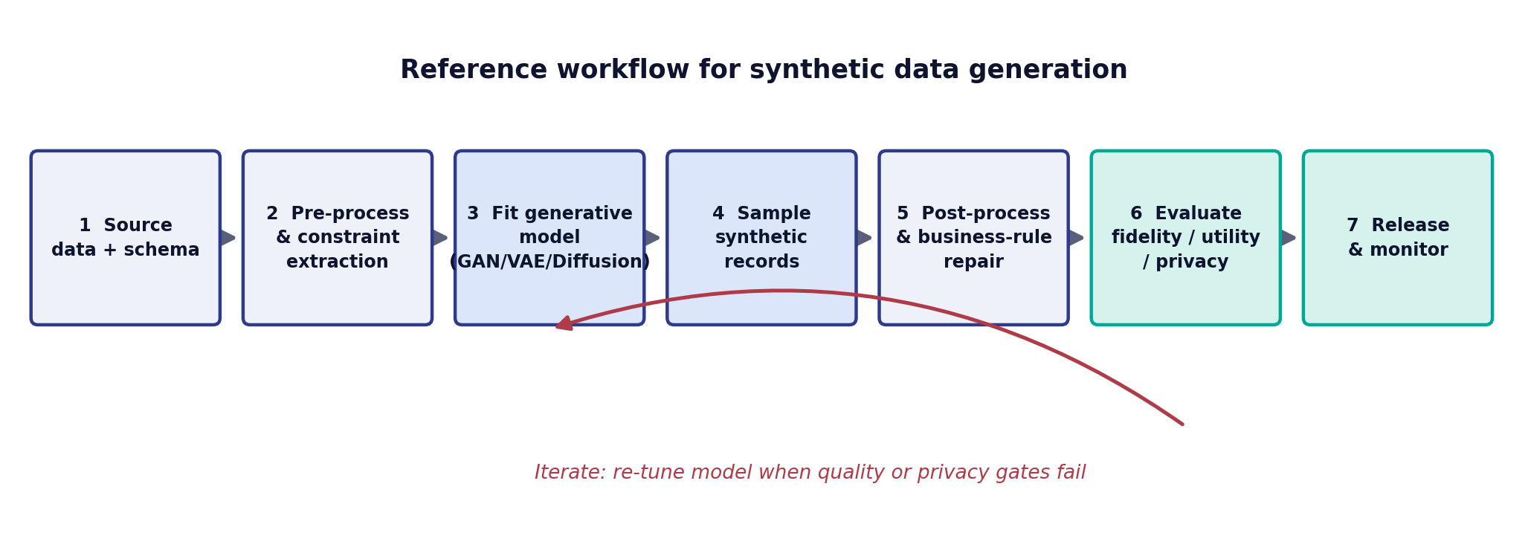
DAY 1 · TOPIC 1
The generation pipeline end to end
Steps 1–4 are modelling
Steps 5–7 decide adoption
Most published work concentrates here — the choice of generative family and its conditioning [3] [5] [11].
Constraint repair and the evaluation gates are what make a dataset releasable in practice [27] [30].
Sources: [3] [5] [11] [27] [30]

Slide 9
DAY 1 · TOPIC 2
Real vs synthetic data, side by side
Dimension | Real data | Synthetic data
Provenance | Recorded from actual events, people or sensors | Sampled from a model fitted to real data [1]
Marginal accuracy | Ground truth by definition | Close but never exact; measured by Kolmogorov–Smirnov (KS)/ Total Variation (TV) distance [29]
Joint structure | All dependencies present, including the ones nobody documented | Only the dependencies the model had capacity to learn [11] [12]
Rare events / tails | Present at their true, often inconveniently low, rate | Systematically under-represented unless explicitly conditioned [11] [27]
Volume | Fixed by what was collected | Unbounded; can be rebalanced by class on demand [11]
Labelling cost | Manual annotation dominates the budget | Labels can be generated alongside synthetic records, potentially reducing manual annotation cost [21] [23]
Privacy exposure | Direct — governed by GDPR, DPDP Act, HIPAA | Reduced but not eliminated; residual attack surface remains [30]
Regulatory status | Personal data | Contested: not automatically outside data-protection scope [30]
Glixify example
What we want to preserve
What we want to avoid
Real Glixify data: measurements from actual wearable/CGM observations.
Synthetic Glixify data: measurements generated from a model that has learned patterns from the real data.
Individual distributions · relationships between metrics
Temporal behaviour · plausible combinations
Relevant missing-data patterns
Exact copying of real records
Memorization of individual users
Unrealistic combinations · broken temporal patterns
Sources: [1] [11] [12] [21] [23] [27] [29] [30]

Slide 10
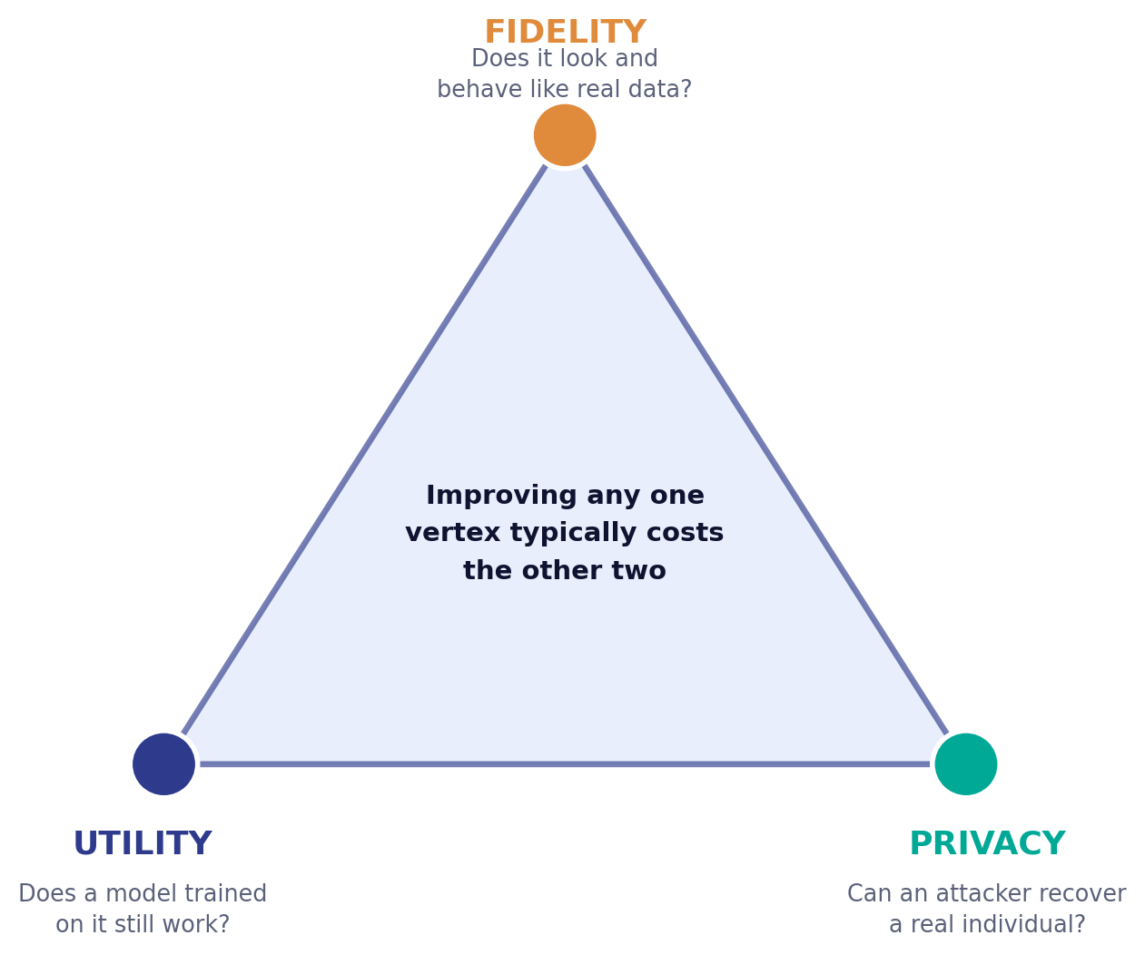
DAY 1 · TOPIC 2
Why you cannot optimise all three at once
Push fidelity too far
A model that reproduces the training distribution perfectly has, in the limit, memorised it. Memorised records are recoverable [27] [29].
Push privacy too far
Differentially private training with a small ε adds enough noise that rare but informative structure is destroyed, and utility collapses [25] [26].
Chase utility alone
Optimising only the downstream score encourages the generator to copy the training set — the highest-utility synthetic dataset is the real one [30].
Sources: [25] [26] [27] [29] [30]

Slide 11
DAY 1 · TOPIC 3
Six reasons organisations adopt synthetic data
1
Data access
2
Privacy & compliance
3
Class imbalance
Development and testing teams are blocked on approvals for production data. Synthetic copies can be provisioned in hours instead of quarters [1] [9].
A generated dataset carrying no real individual reduces the compliance surface for sharing across borders and with vendors [1] [30].
Fraud, machine failure and rare disease are too infrequent to train on. Conditional generators can oversample the minority class directly [11] [28].
4
Annotation cost
5
Scenario coverage
6
Data sharing
In vision and robotics, labels are the expense. A renderer emits pixel-perfect segmentation and depth for free [21] [22] [23].
Safety-critical systems must be tested against events that have not yet occurred. Those scenarios can only be generated [21] [23].
Benchmarks, competitions and research collaborations need a shareable stand-in for data that cannot leave the building [9] [28].
STIXIS / GLIXIFY EXAMPLE — POTENTIAL USE OF SYNTHETIC DATA IN A GLIXIFY-STYLE APPLICATION
Synthetic data can provide a representative environment for application development, testing and analytics experimentation without requiring every development activity to operate directly on real user records.
Sources: [1] [9] [11] [21] [22] [23] [28] [30]
Notes:
Frame Glixify as a potential use case. Do not claim that Glixify currently uses synthetic data unless that is confirmed internally.

Slide 12
DAY 1 · TOPIC 3
The regulatory argument, stated carefully
The claim that holds
The claim that does not
Generating data from a model trained under a differential-privacy mechanism gives a quantified, provable bound on what any downstream analyst can learn about any one training record [24] [25] [26].
That synthetic data is automatically anonymous. Controlled evaluations show that without a formal guarantee, synthetic datasets either leak to inference attacks or lose the utility that motivated them [30].
Under GDPR, data is outside scope only if re-identification is reasonably impossible — a property of the generation process, not of the word 'synthetic' [30].
Data-protection and sector-specific rules may still apply depending on the jurisdiction, data, organisation and intended use. Synthetic data should therefore be assessed for residual privacy risk rather than assumed to be exempt.
Practical consequence: treat a synthetic release as a controlled release. Document the generator, the privacy budget if any, and the audit results [1] [30].
Sources: [1] [24] [25] [26] [30]

Slide 13
DAY 1 · TOPIC 3 · STIXIS EXAMPLE
A Stixis Example: Glixify
Bringing together wearable and continuous glucose monitoring data
Wearables + CGM
Data sources
Glixify is a Stixis application scenario where data from wearable devices and continuous glucose monitors (CGMs) can be brought together for analytics and application development.
Glixify
Stixis application
Depending on the device and source, the data can include:
Blood glucose
Heart rate
Heart rate variability (HRV)
SpO₂
Sleep
Activity
Timestamped measurements
Device / source information
Health & activity metrics
Glucose · HR · HRV · SpO₂ · sleep · activity
Analytics / AI / Testing
Where synthetic data becomes relevant
Illustrative application scenario — metric names only; no user data shown, and no claim about any production system.
Notes:
This is where synthetic data becomes relevant to a real application. Glixify can involve multiple physiological and activity-related measurements coming from different sources. Working with such data introduces the same challenges we have discussed: relationships between variables, time dependence, missing observations, different sampling frequencies and privacy considerations.
Note: the items on this slide are metric names, not claims about any particular user's measurements. Do not add specific patient/user values unless approved Glixify data is available to show.

Slide 14
DAY 1 · TOPIC 3 · STIXIS EXAMPLE
What Makes Glixify Data Interesting for Synthetic Data?
A Glixify-style dataset is not just a collection of independent columns.
Individual measurements
But the important information is also in the relationships
Blood glucose
Heart rate
HRV
SpO₂
Sleep duration
Activity
Timestamp
Measurements change over time.
Activity and heart rate can be related.
Sleep characteristics can be associated with subsequent activity or physiological measurements.
Glucose measurements form a time-dependent sequence.
Different devices may produce data at different frequencies.
Missing observations can occur because of device or connectivity gaps.
KEY TEACHING POINT
Synthetic data should preserve the relationships that matter for the intended use case — not simply make every individual column look realistic.
Illustrative application scenario — metric names only; no user data shown, and no claim about any production system.
Notes:
This reinforces the Day 1 teaching point that synthetic data must preserve relationships rather than only individual-column realism.

Slide 15
DAY 1 · TOPIC 3 · STIXIS EXAMPLE
The Synthetic Data Question for Glixify
Imagine a large collection of real Glixify records
We may want to:
Develop and test analytics without exposing real user records
Test applications at larger scale
Create representative datasets for development
Explore unusual but plausible scenarios
Share representative data with teams that do not need access to real user records
THE QUESTION
Can we generate synthetic Glixify-style data that preserves the important statistical and temporal relationships without simply copying real users?
Real data
Learn structure
Generate synthetic data
Validate
Use
Evaluated on three axes: Fidelity + Utility + Privacy
Illustrative application scenario — metric names only; no user data shown, and no claim about any production system.
Notes:
Emphasize that the goal is not to create random numbers that look like health data. The goal is to create data that is useful for the intended application while evaluating Fidelity + Utility + Privacy. This connects directly to the Day 1 objective that synthetic data should be realistic/informative while addressing privacy concerns.

Slide 16
DAY 1 · TOPIC 3 · STIXIS EXAMPLE
Where Synthetic Data Fits in Glixify
1
Real Glixify data
2
Profile the data
3
Learn the data structure
Wearables + CGM + timestamps
Distributions · missing values · relationships · temporal patterns
Statistical dependencies · conditional relationships · temporal behaviour
4
Generate synthetic records
5
Compare with real data
6
Evaluate
Synthetic Glixify-style data
Distributions · relationships · temporal characteristics
Fidelity | Utility | Privacy
The synthetic dataset is useful only if it preserves the properties required by the application.
Illustrative application scenario — metric names only; no user data shown, and no claim about any production system.
Notes:
Walk the six steps left to right, then top to bottom. Point out that evaluation (step 6) is part of the generation workflow, not an afterthought.

Slide 17
DAY 1 · TOPIC 4
Types of synthetic data — by degree of synthesis
Fully synthetic
Partially synthetic
Hybrid
Every value in every record is generated. No original record survives in the output. Potentially lower direct disclosure risk than partial synthesis, but privacy still depends on the generation process and evaluation — not automatic [1] [9].
Only sensitive or identifying attributes are replaced; the rest of the real record is retained. Better utility, weaker guarantee [1].
Real and generated records are mixed, typically to augment a minority class while keeping the majority real [11] [28].
 | Privacy risk | Typical utility | When it is the right call
Fully synthetic | Lowest | Moderate to high | External sharing, vendor evaluation, public benchmarks
Partially synthetic | Medium | High | Internal analytics where only direct identifiers are the problem
Hybrid | Inherits the real subset | Highest | Rare-event model training inside a trusted boundary
Sources: [1] [9] [11] [28]

Slide 18
DAY 1 · TOPIC 4
Types of synthetic data — by modality
Modality | What makes it hard | Workhorse methods | Primary quality test
Tabular | Mixed continuous and categorical columns, multi-modal marginals, severe class imbalance [11] | CTGAN, TVAE, TabDDPM, LLM-based GReaT [11] [12] [13] | TSTR against a real hold-out [10]
Text | Discrete tokens block gradient flow; semantic validity is not checkable by statistics [14] [16] | Back-translation, EDA, LLM self-instruction [14] [15] [16] | Human or model-graded task accuracy [16] [17]
Image / video | High dimensionality and the sim-to-real domain gap [21] [22] | Latent diffusion, StyleGAN, graphics renderers [8] [20] [21] | FID plus real-data validation accuracy [21] [23]
Time series | Temporal dependence and non-stationarity must survive generation [10] | RCGAN and conditional recurrent generators [10] | TSTR on a forecasting task [10]
Relational / multi-table | Foreign keys and cardinality must hold across generated tables [9] | Synthetic Data Vault recursive modelling [9] | Referential integrity checks plus TSTR [9]
Glixify example — primary modality: time-series / tabular
Teaching point
A Glixify-style dataset can contain:
Numerical measurements · categorical / device attributes · timestamped observations · repeated measurements · missing observations · relationships across variables
A real-world application may combine several data characteristics even when we represent the dataset in a simple table.
Sources: [8] [9] [10] [11] [12] [13] [14] [15] [16] [17] [20] [21] [22] [23]
Notes:
Glixify example: a wearable + CGM dataset looks like a single table but carries time-series, repeated-measurement and missing-data structure at the same time.

Slide 19
DAY 1 · TOPIC 4 · TIME SERIES
From Simple Columns to Time-Series Relationships
Glixify also illustrates why synthetic data gets harder as we move from simple tabular data toward time-series data.
TABULAR VIEW
We also need to consider
Timestamp | Glucose | HR | HRV | SpO₂ | Activity
t₁ | — | — | — | — | —
t₂ | — | — | — | — | —
t₃ | — | — | — | — | —
How measurements change over time
Dependencies between variables
Repeated measurements from the same source
Different measurement frequencies
Missing observations
Plausible combinations of measurements
The values themselves are only part of the problem.
KEY MESSAGE
For time-series data, realism includes temporal behaviour — not just realistic-looking individual values.
Illustrative application scenario — metric names only; no user data shown, and no claim about any production system.
Notes:
This connects with the deck's treatment of time-series synthetic data, where temporal dependence and non-stationarity need to be preserved. The table cells are deliberately blank: we are showing structure, not data.

Slide 20
DAY 1 · TOPIC 5
Where synthetic data is already in production
Sector | Problem it solves | Evidence in the literature
Healthcare | Sharing patient-level data for research without exposing records; augmenting rare conditions | medGAN generates realistic multi-label patient records from EHRs and is evaluated for disclosure risk [28]; reviews survey dozens of deployed tabular health generators [44]
Financial services | Fraud and AML model training where positive cases are a fraction of a percent | Conditional tabular generators are used to rebalance minority classes and to create shareable test data [11] [46]
Autonomous systems & robotics | Perception training for scenarios that are dangerous or rare to record; closing the reality gap for detection and pose estimation | Simulator datasets such as Playing for Data and SYNTHIA supply pixel-perfect labels at scale [21] [23]; domain randomisation lets simulation-trained networks transfer to real scenes [22]
Software engineering | Populating non-production environments with realistic test data | The Synthetic Data Vault models relational databases and generates referentially consistent test data [9]
Foundation-model training | Extending or curating pre-training and instruction data | Self-generated instruction data measurably improves instruction following [16]; curated synthetic 'textbook' data improves small-model performance [17]
Example: wearable + CGM application — potential synthetic-data use cases
Discussion question
Development datasets · application testing · analytics experimentation · scenario generation · scale testing · controlled data sharing
Which properties of the original data would we need to preserve for each use case?
Sources: [9] [11] [16] [17] [21] [22] [23] [28] [44] [46]
Notes:
The definition of 'good synthetic data' depends on the intended use.

Slide 21
DAY 1 · TOPIC 6
Discriminative vs generative modelling
Discriminative: p(y | x)
Generative: p(x) or p(x | y)
Learns a decision boundary. Given an input, returns a label. Cannot produce new inputs, because it never models how x is distributed [7].
Learns the distribution the data came from. Sampling from it yields new data points that never existed — this is the capability synthetic data rests on [7].
Generative models differ mainly in how they represent p(x): exactly, through a bound, through a score function, or only implicitly through a sampler [7].
That representational choice determines everything practical — sampling speed, mode coverage, trainability, and whether a likelihood is available for evaluation [7] [27].
Transformers made autoregressive generation scale, which is why the same architecture now generates text, code and even tabular rows [19] [34] [13].
Sources: [7] [13] [19] [27] [34]

Slide 22
DAY 1 · TOPIC 8
Core architectures at a glance
GAN
VAE
Diffusion
Two networks in competition
Encode, regularise, decode
Destroy, then learn to rebuild
A generator turns noise into samples; a discriminator tries to tell them from real data. Neither has an explicit density — training is a game, not an optimisation [3].
An encoder maps data to a distribution over latent codes, a decoder maps codes back. A KL term keeps the latent space samplable [4].
Noise is added to data over many steps until nothing is left; a network learns to reverse each step, and sampling runs the reversal from pure noise [5] [6].
One sentence to carry into Day 2
GANs learn by being caught out, VAEs learn by compressing and reconstructing, diffusion models learn by undoing noise — and those three learning signals explain every behavioural difference between them.
Sources: [3] [4] [5] [6]

Slide 23
DAY 1 · TOPIC 8
The fourth architecture: autoregressive transformers
Generate one piece at a time — each word, token or column value is predicted from everything generated so far, using a transformer [19] [34].
Training is straightforward: predict the next piece, score it against the real data, repeat — no adversarial game and no approximations [19].
Discrete data is native. Tokens are exactly what the model predicts, which is why this family dominates text and code generation [19] [34].
Scaling the same recipe produced in-context learning: a large model can generate labelled examples for a task it was never fine-tuned on [19].
The surprise result: serialise a table row into a sentence, fine-tune an LLM on it, and you get a competitive tabular generator that respects column semantics [13].
Cost of the approach: generation is sequential and therefore slow, and continuous columns must be discretised or tokenised, which loses precision [13].
Sources: [13] [19] [34]

Slide 24
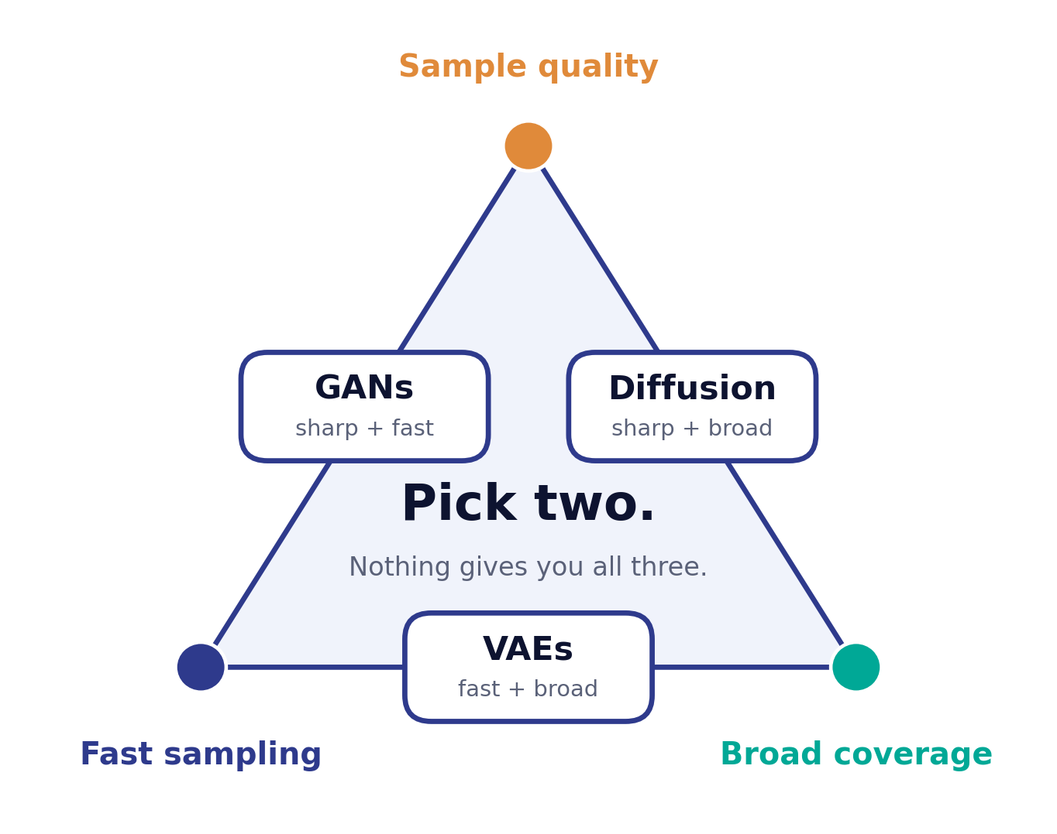
DAY 1 · TOPIC 9
The generative trilemma
What the trilemma says
Pick two of three: sample quality, sampling speed, and coverage of the data's variety. GANs give up coverage, VAEs give up sharpness, diffusion gives up speed [3] [5] [33].
Why it matters for synthetic data
Coverage is not optional here. A generator that misses modes silently deletes subpopulations from your dataset [27].
A starting point, not a rule
CTGAN and diffusion-based approaches are useful starting points for tabular work; the right choice depends on data characteristics, compute budget and privacy needs [12].
Sources: [3] [5] [12] [27] [33]

Slide 25
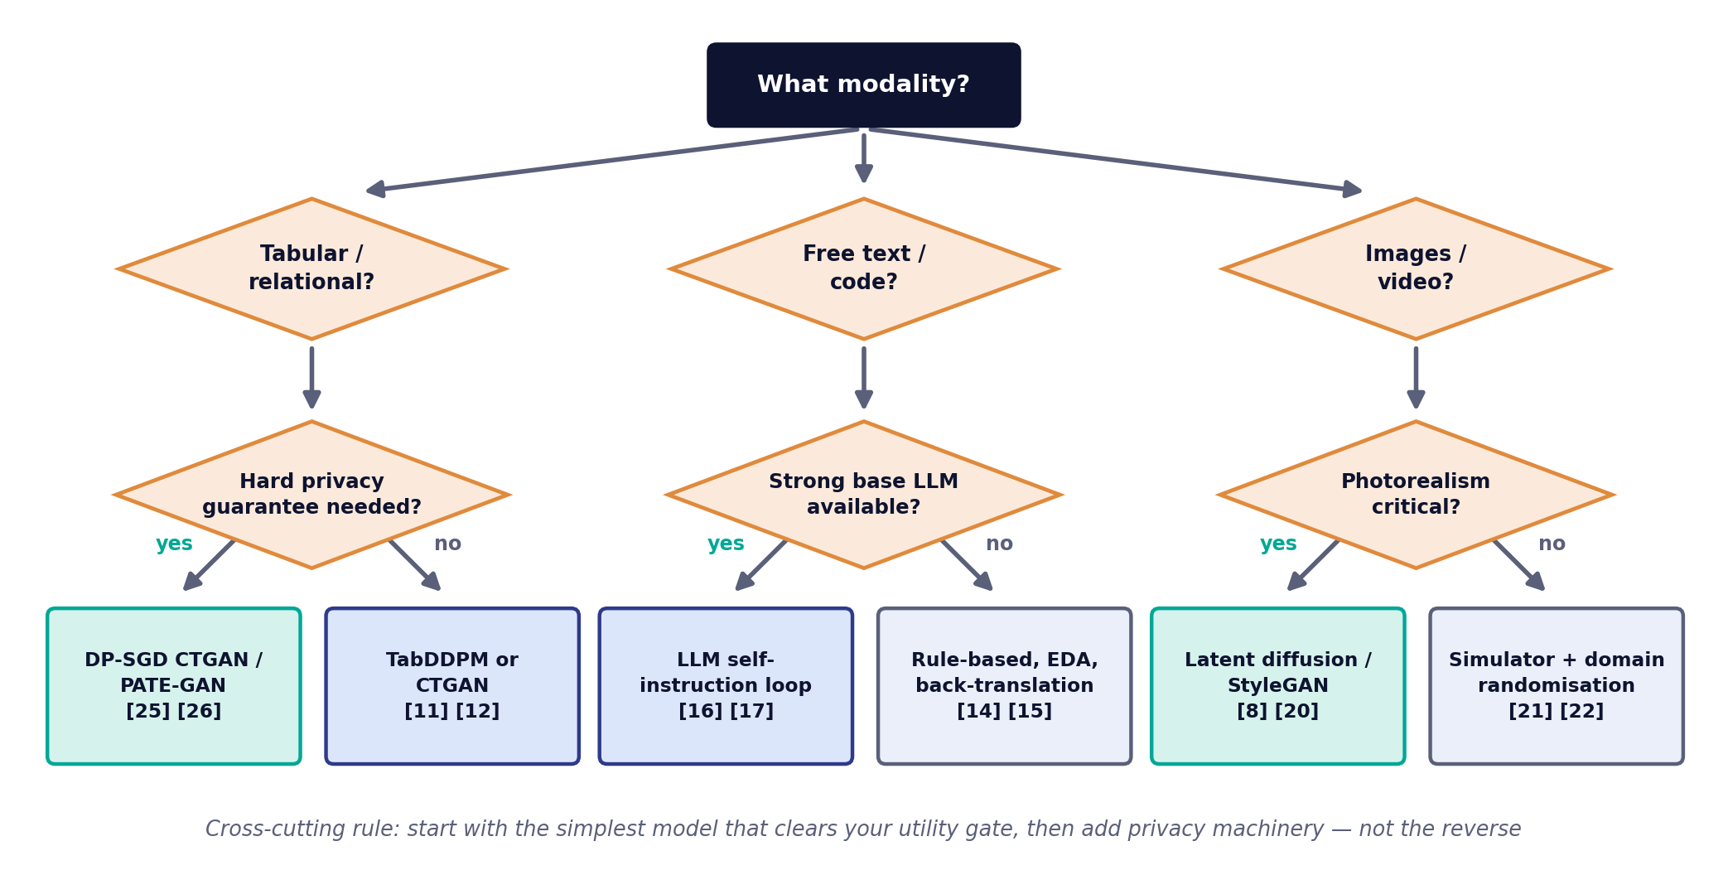
DAY 1 · TOPIC 9
Choosing an approach: a decision path
This chart is the deliverable of Day 1. By the end of Day 3 you should be able to defend every branch of it with a metric.
Sources: [8] [11] [12] [14] [15] [16] [17] [20] [21] [22] [25] [26]

Slide 26
DAY 1 · LAB SCENARIO
Day 1 Lab: From Real Data to a Synthetic Copy
SCENARIO
You are working with a simplified dataset inspired by a wearable + CGM application such as Glixify.
Your goal: before generating synthetic data, understand…
Application context
What variables exist?
Which are numerical? Which are categorical?
Are there missing values?
Which relationships appear important?
Are there temporal patterns?
What should a synthetic version preserve?
Use the Glixify-style wearable + CGM scenario to think about which properties matter for a real application.
Important: the classroom dataset is intentionally simplified. It represents the type of data an application such as Glixify may work with; it is not intended to reproduce a complete production Glixify dataset.
The classroom dataset is a simplified teaching dataset — a Glixify-inspired scenario, not a Glixify production dataset.
Notes:
Day 1 is Profile → Understand → Baseline → Compare. Do not require students to treat the exercise as a full clinical time-series problem; the temporal-generation discussion is introduced conceptually and revisited later.
This remains consistent with the existing Day 1 lab objectives; the Glixify scenario simply supplies the application context.

Slide 27
DAY 1 · LAB SCENARIO
Day 1 Lab: The Simplified Teaching Dataset
Column | Type | Example purpose
timestamp | datetime | Observation time
glucose | numerical | CGM measurement
heart_rate | numerical | Heart rate
hrv | numerical | Heart-rate variability
spo2 | numerical | Oxygen saturation
sleep_duration | numerical | Sleep-related measure
activity_level | categorical | Low / Moderate / High
steps | numerical | Activity volume
sleep_quality | categorical | Sleep classification
device_type | categorical | Source / device category
DAY 1 FLOW
Profile
Understand
Baseline
Compare
Instructor note
Do not require students to model all variables as a true clinical time-series problem in the 2-hour lab. Temporal generation is introduced conceptually and revisited in later sessions.
Field names describe the structure of the teaching dataset; the values come from the dataset supplied for the lab.
Notes:
Keep the lab manageable: Profile → Understand → Baseline → Compare. The more sophisticated temporal-generation discussion is introduced conceptually.

Slide 28
DAY 1
What we established today
1
Synthetic data is generated from a fitted model, not de-identified from real records — and that distinction drives its whole risk profile [1] [30].
2
Fidelity, utility and privacy form a trade-off, not a checklist. Every subsequent design decision is a position on that triangle [27] [30].
3
Four main generative families are in serious use — GANs, VAEs, diffusion and autoregressive models — and each has a characteristic failure mode that you can predict from how it learns [3] [4] [5] [7].
4
Modality decides the method before anything else does — tabular, text and image work do not share tooling [11] [16] [21].
Tomorrow: we build each of these generators ourselves.
Sources: [1] [3] [4] [5] [7] [11] [16] [21] [27] [30]

Slide 29
DAY 1 → DAY 2
From Glixify Data Understanding to Generation
DAY 1
DAY 2
DAY 3
Understand the real data
Generate synthetic data
Evaluate whether we can trust it
GLIXIFY CONTEXT — FOR A WEARABLE + CGM APPLICATION
Real observations
Learn structure
Generate
Compare
Evaluate
Synthetic data generation is not the end of the process. Validation is part of generation.
Notes:
This matches the overall course arc of Real → Generate → Trust.
Bridge: Tomorrow we move from a simple baseline to an actual generative model. Then, on Day 3, we ask the harder question: how do we know whether the generated data is good enough to trust?

Slide 30
DAY 2
Synthetic Data Generation Techniques
Data in, synthetic data out: choose an approach, train it, and inspect the result.
1
2
3
4
5
6
Tabular data
Text
Images
GANs
VAEs
Diffusion models
Theory 3 hours · Hands-on lab 2 hours

Slide 31
DAY 2 · THE BIG PICTURE
The Day 2 workflow: data in, synthetic data out
Start from your data — Know your columns, types and constraints before choosing anything. Tabular, text and image data each point to a different kind of generator [11] [16] [21].
1
Choose an approach — Follow the Day 1 decision path: CTGAN, TVAE or TabDDPM for tables; augmentation or LLM generation for text; simulation or diffusion for images [8] [11] [12] [16] [21].
2
Train and generate — Fit the model, then sample new records. Conditioning lets you steer the output, for example to oversample a rare class [11].
3
Inspect the synthetic data — Compare marginals and correlations with the real data, check business rules and constraints, and note what needs repair before Day 3's formal evaluation [9] [11] [29].
4
Sources: [8] [9] [11] [12] [16] [21] [29]

Slide 32
DAY 2 · TOPIC 1
Tabular data: deceptively difficult
1
Mixed column types
2
Non-Gaussian, multi-modal marginals
3
Severe class imbalance
A single row holds continuous, ordinal, categorical and binary fields. One network must emit all of them with the right type and range [11].
Income, transaction value and duration columns are skewed and multi-peaked. Min-max scaling destroys the structure and causes vanishing gradients [11].
A category appearing in 0.3% of rows is rarely sampled in a training minibatch, so the generator never learns it [11].
4
Hard constraints
5
Cross-table integrity
6
No perceptual check
Discharge date ≥ admission date; totals equal the sum of line items. Statistical models do not respect arithmetic unless forced to [9].
Foreign keys, cardinalities and parent–child relationships must survive generation across a whole schema [9].
You cannot eyeball a synthetic table the way you can eyeball a synthetic face. Everything must be measured [27] [29].
Sources: [9] [11] [27] [29]

Slide 33
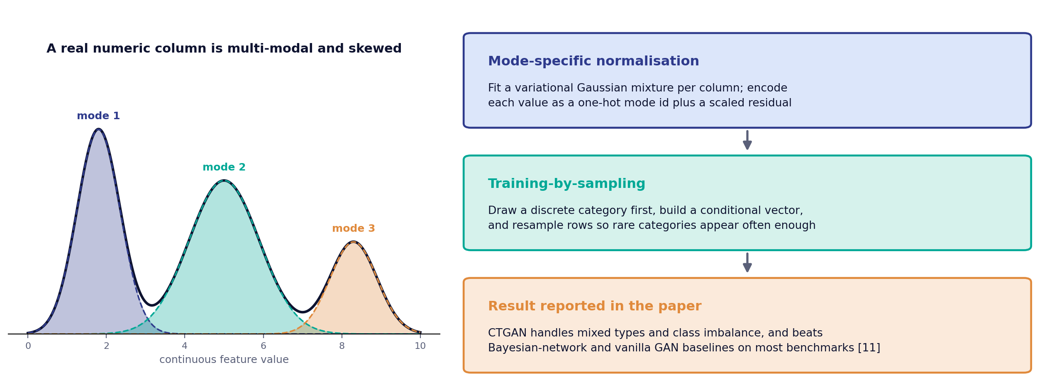
DAY 2 · TOPIC 1
CTGAN: two ideas that made tabular GANs work
Both ideas attack the same root problem — a naive minibatch never shows the generator the parts of the distribution that matter least often and cost most when missing [11].
Sources: [11]

Slide 34
DAY 2 · TOPIC 1
The tabular toolbox: three models to know
Method | Mechanism | Reported strength | Watch out for
CTGAN | Conditional GAN with mode-specific normalisation and training-by-sampling [11] | Strong on imbalanced categoricals; the de facto baseline [11] | Adversarial instability; needs careful epoch selection
TVAE | Variational autoencoder over the same tabular encoding [11] | More stable to train than CTGAN; competitive on several benchmarks [11] | Tends to over-smooth continuous columns
TabDDPM | Multinomial diffusion for categoricals plus Gaussian diffusion for continuous columns [12] | Outperforms GAN and VAE alternatives across a wide benchmark suite [12] | Slow sampling; higher training cost
Also worth knowing: GReaT fine-tunes a language model on rows written as text [13]; SDV models multi-table databases while keeping foreign keys intact [9]; PrivBayes adds a formal privacy guarantee [47].
Sources: [9] [11] [12] [13] [47]

Slide 35
DAY 2 · TOPIC 1
Constraints: the part that decides adoption
A synthetic dataset that is statistically excellent but arithmetically impossible will be rejected by the first engineer who loads it. Constraint handling is not polish it is the acceptance test.
Constraint class | Example | How to enforce it
Range / domain | Age between 0 and 120; status in a fixed code list | Encode categoricals as one-hot and clip continuous outputs to observed support [11]
Inter-column arithmetic | total = quantity × unit_price | Generate the independent columns and compute the dependent one deterministically after sampling [9]
Temporal ordering | discharge_date ≥ admission_date | Generate the anchor date plus a non-negative duration, then reconstruct [9] [10]
Uniqueness / keys | Primary keys must be unique; foreign keys must resolve | Assign keys post hoc and generate child tables conditioned on the parent [9]
Business rules | A closed account cannot have a future transaction | Post-generation rejection sampling or repair, with the rejection rate tracked as a quality metric [9]
Sources: [9] [10] [11]

Slide 36
DAY 2 · TOPIC 2
Synthetic text: augment, or generate and filter
Augment what you have
Generate with an LLM
Synonym replacement, random insertion, swap and deletion (EDA), plus back-translation through a pivot language. Cheap, label-preserving, and effective on small or low-resource training sets [14] [15].
Prompt a large language model to write new instances outright — including instructions, inputs and outputs — then filter aggressively before anything is used [16] [17] [19].
GANs suit images better than text: words are discrete tokens, so the discriminator's feedback cannot flow back to the generator [14] [16].
The practical bottleneck has moved from generation to filtering: producing text is now cheap, deciding which text to keep is not [16] [17].
Sources: [14] [15] [16] [17] [19]

Slide 37
DAY 2 · TOPIC 2
Quality control for synthetic text
Filter | What it removes | Why it matters
Near-duplicate detection | Instances too similar to existing pool entries, typically by ROUGE-L overlap [16] | Without it the pool collapses onto a few templates and diversity dies [16]
Validity checking | Malformed outputs, empty fields, instructions with no possible answer [16] | Invalid instances teach the model to produce invalid outputs
Label consistency | Augmented text whose meaning no longer matches its label [14] | Synonym substitution can silently flip sentiment or negation [14]
Rule of thumb from the literature: generation is the cheap half of the pipeline, filtering is where the quality is actually created [16] [17].
Sources: [14] [16] [17]

Slide 38
DAY 2 · TOPIC 3
Synthetic imagery: two fundamentally different routes
Route A — Graphics simulation
Route B — Learned generation
Render the scene in a 3-D engine. Geometry is known, so semantic masks, depth maps and 3-D poses are emitted exactly, for free. Photorealism is limited by the renderer, producing a domain gap [21] [23].
Sample from a model fitted to real photographs. Photorealism is high and improving; the cost is that labels are not automatic and must be induced, conditioned on, or inferred [8] [20].
 | Label quality | Photorealism | Controllability | Typical use
Graphics simulation [21] [23] | Exact, dense, free | Moderate | Total — you author the scene | Perception, robotics, safety scenarios
GAN synthesis [20] | Needs conditioning | High, fast to sample | Latent-space editing | Face and texture augmentation
Latent diffusion [8] | Needs conditioning | Highest reported | Text and image conditioning | Open-domain image augmentation
Sources: [8] [20] [21] [23]

Slide 39
DAY 2 · TOPIC 3
The domain gap, and how it is closed
1
Domain randomisation
Deliberately vary lighting, textures, camera pose and distractors beyond realism, so the real world looks to the network like just another variation. Detectors trained only in simulation then transfer to real images [22].
2
Mixed training sets
Pre-train on large synthetic volume, then fine-tune on the small real set. Consistently better than either source alone in the segmentation literature [21] [23].
3
Real-data validation
Never validate on synthetic data. The domain gap is invisible to a synthetic test set by construction, so hold-out data must be real [22].
The same three moves transfer directly to tabular work: randomise what you cannot model, mix synthetic with real, and always validate against real hold-out data [10] [22].
Sources: [10] [21] [22] [23]

Slide 40
DAY 2 · TOPIC 4 · IN SIMPLE WORDS
GANs in simple words
1
The Generator
"I will create fake data that looks real." It starts from random noise and slowly learns to produce something convincing.
2
The Discriminator
"I will try to catch the fake data." It looks at real and generated examples side by side and learns to tell them apart.
3
The arms race
As the Discriminator gets better at spotting fakes, the Generator is forced to get better at fooling it — and vice versa.
In practice, look at the output, not just the loss: if the generator finds one sample the discriminator cannot reject, everything starts to look alike (mode collapse) while the loss looks healthy [41]. The formal maths is in the Advanced appendix.
A conceptual summary — formal treatment in the Advanced appendix

Slide 41
DAY 2 · TOPIC 5 · IN SIMPLE WORDS
VAEs in simple words
1
Compress
An encoder squeezes each real example down into a small, dense summary — a latent representation of what matters about it.
2
Sample
Instead of one fixed summary, the model learns a range of plausible summaries and draws a new point from that range at random.
3
Reconstruct / generate
A decoder expands the sampled point back out into something in the shape of the original data — a reconstruction, or a brand-new example.
That is the whole idea: compress, sample, rebuild. Because the decoder can rebuild from any sampled point, it can generate new examples. The formal maths (ELBO, reparameterisation) is in the Advanced appendix.
A conceptual summary — formal treatment in the Advanced appendix

Slide 42
DAY 2 · TOPIC 5
VAEs: what you gain, what you give up
Advantages
Limitations
Stable, non-adversarial training. A smooth latent space that supports interpolation, conditioning and anomaly scoring [4] [7].
Averaging over plausible outputs produces blurred images and over-smoothed numeric columns. Some latent dimensions can end up unused [7] [38].
Variant | Modification | Use case
Conditional VAE | Conditions encoder and decoder on a label | Generating a specified class — the VAE analogue of a conditional GAN
TVAE [11] | Tabular encoding with mode-specific normalisation | Frequently matches or beats CTGAN with far less tuning [11]
Sources: [4] [7] [11] [38]

Slide 43
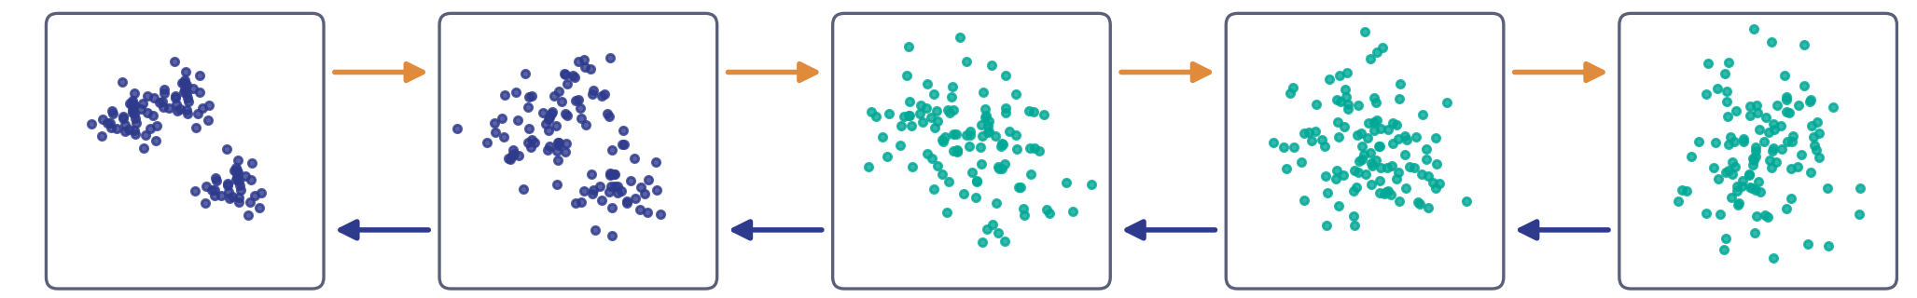
DAY 2 · TOPIC 6
Diffusion models: destroy, then learn to rebuild
Forward process (fixed): gradually add noise until nothing is left →
Real data
Pure noise
← Reverse process (learned): a network removes a little noise at each step
To generate new data, start from pure noise and run the learned reverse steps. The forward process has no learned parameters — the only thing the model learns is how to remove noise [5] [6].
Sources: [5] [6]

Slide 44
DAY 2 · TOPIC 6
Steering diffusion, and what it costs
1
Conditioning
Give the model a class label or a partial record while it generates, so the output is steered toward what you asked for [8] [40].
2
Sampling cost
Generating needs many sequential network passes — the main practical drawback against GANs, and the reason the trilemma bites [5] [33].
3
Diffusion for tables: TabDDPM
TabDDPM handles numeric and categorical columns with two kinds of noise, and reports better results than GAN and VAE alternatives across benchmarks [12].
Sources: [5] [8] [12] [33] [40]

Slide 45
DAY 2 · LEARNING CHECK
Five-minute check: compare the families
1
The question
Why does diffusion generally need many more sampling steps to generate one example than a GAN does?
2
Work it through
Think back to how each family generates a sample: a GAN runs the Generator once. Diffusion reverses noise step by step — how many steps does that take?
3
Connect it back
Which corner of the generative trilemma is diffusion trading away to win on quality and coverage?
This sampling cost is exactly why the trilemma slide put diffusion and GANs on opposite sides of the speed trade-off.
Discussion — no citations required

Slide 46
DAY 2 · LAB
Hands-on: train CTGAN, then watch the rest
1
Load and inspect — Load Day 1's dataset into a dataframe. Check column types, value ranges and missing values before any model sees it [11].
2
Train CTGAN — Fit the conditional tabular GAN with the provided default settings. Log the generator and discriminator loss as training runs [11] [35].
3
Generate and compare — Generate an equal-sized synthetic dataset and compare it with the real dataset, column by column [11].
4
Visualise and check correlations — Plot marginal distributions side by side and inspect the correlation matrix for anything that drifted [11].
5
Instructor demo — Watch TVAE and TabDDPM fit on the same data, and conditional sampling balance a minority class. Keep today's comparison table — Day 3 adds the utility and privacy columns [11] [12].
Sources: [11] [12] [35]

Slide 47
DAY 2
What we built today
1
Tabular synthesis is a constraint problem as much as a modelling problem: mode-specific normalisation and conditional sampling exist because naive training fails [11].
2
Text generation moved to autoregressive models because discrete tokens block adversarial gradients — and the hard part is now filtering, not generating [16].
3
Image synthesis splits into simulation, which gives free exact labels, and learned generation, which gives photorealism. The domain gap decides which you need [21] [22].
4
GANs, VAEs and diffusion fail in characteristic ways — collapse, blur and latency respectively — and every one of those is predictable from the training objective [3] [4] [5].
Tomorrow: we find out whether any of it is good enough to release.
Sources: [3] [4] [5] [11] [16] [21] [22]

Slide 48
DAY 3
Quality, Validation, Privacy & Industry Applications
Deciding whether a synthetic dataset is fit to release — and proving it.
1
2
3
Synthetic data quality
Privacy
Illustrative Stixis-style use case
Theory 3 hours · Hands-on lab 2 hours

Slide 49
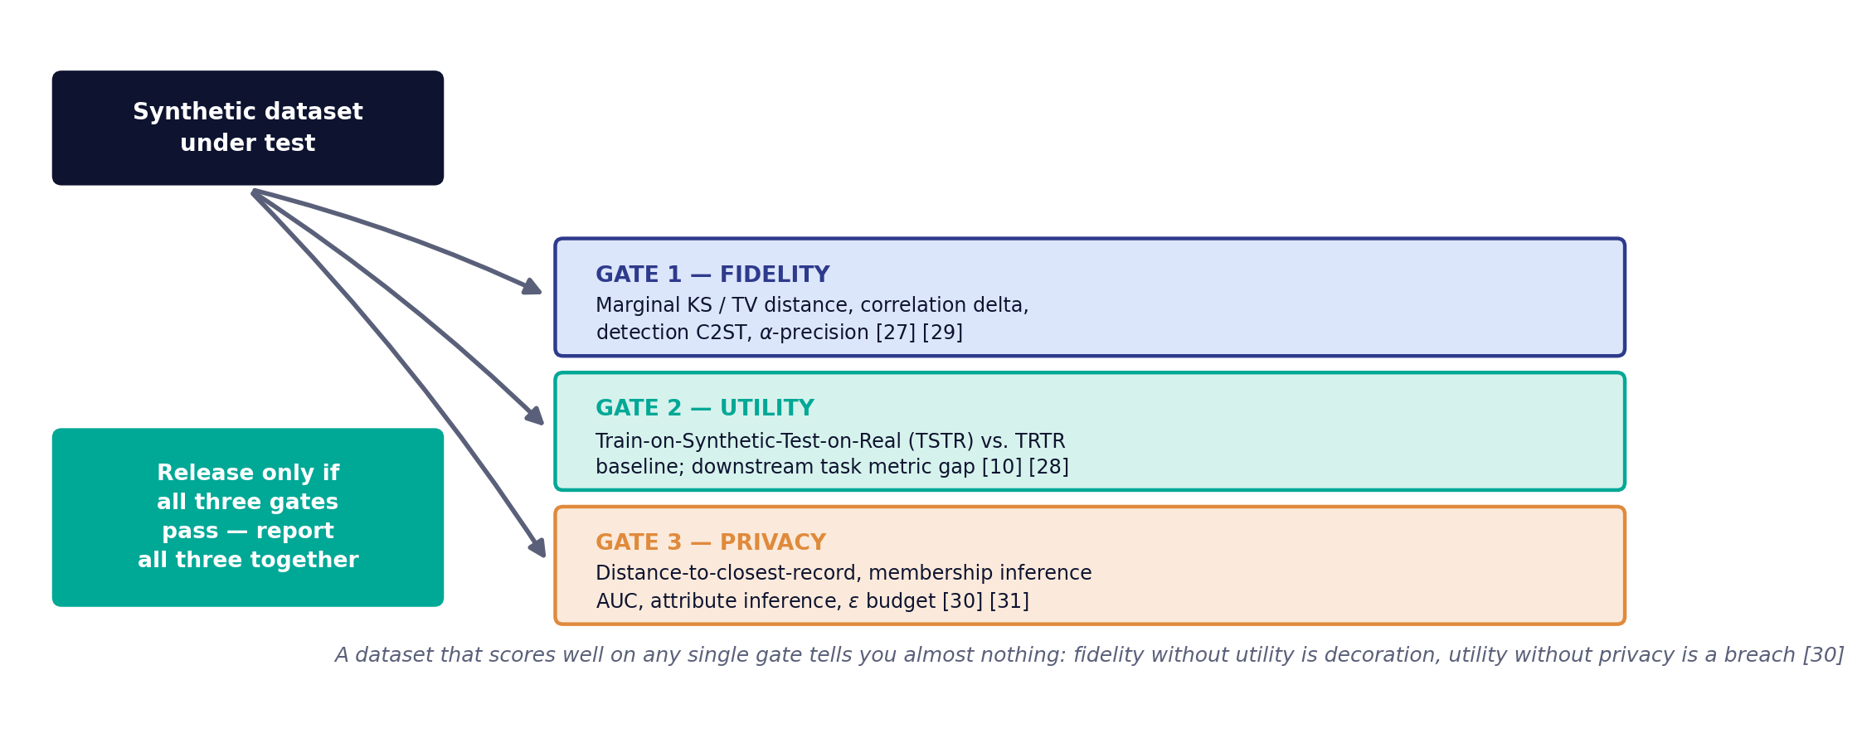
DAY 3 · TOPIC 1
Quality is three gates, not one score
Report all three together, always. A single headline number invites the reader to assume the other two were fine [27] [30].
Sources: [10] [27] [28] [29] [30] [31]

Slide 50
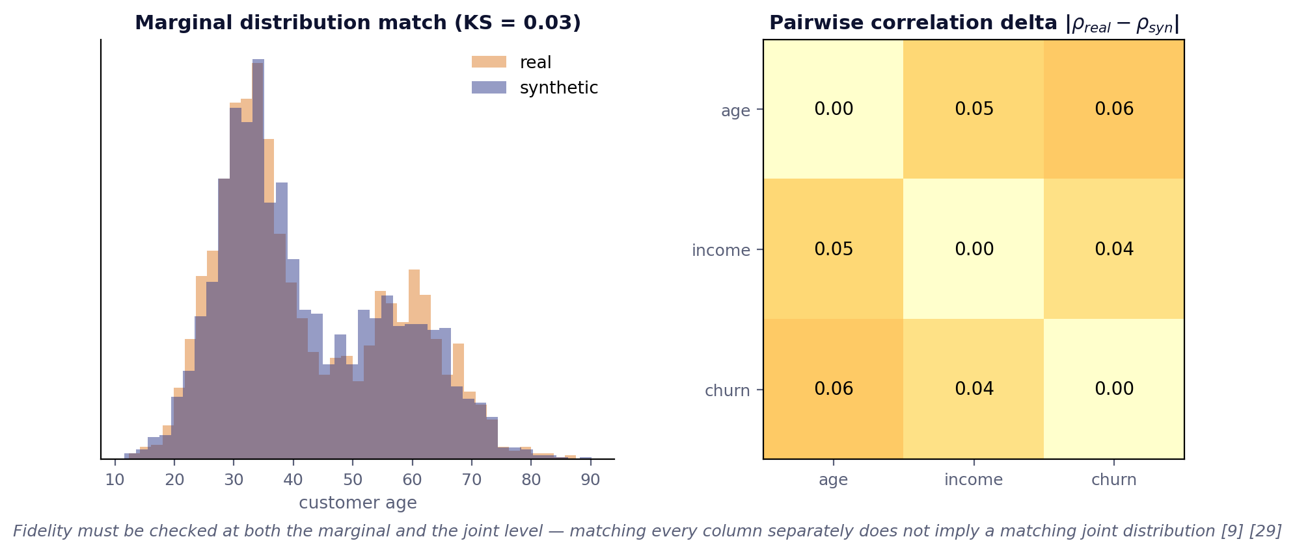
DAY 3 · TOPIC 1
Gate 1 — Fidelity: does it look like the real thing?
Level | Metric | What a failure looks like
Marginal (per column) | Kolmogorov–Smirnov statistic; total variation distance for categoricals [29] | A column's distribution is shifted or has lost a mode
Joint (pairwise) | Correlation / mutual-information delta matrix [9] [29] | Every column is right on its own, but the relationships between them are gone
Distributional | Classifier two-sample test (C2ST); FID for images [42] | A simple classifier separates real from synthetic almost perfectly
Sample-level | Realism score (α-precision) — the share of synthetic points that look like plausible real ones [27] | A minority of synthetic records are outright implausible
Sources: [9] [27] [29] [42]

Slide 51
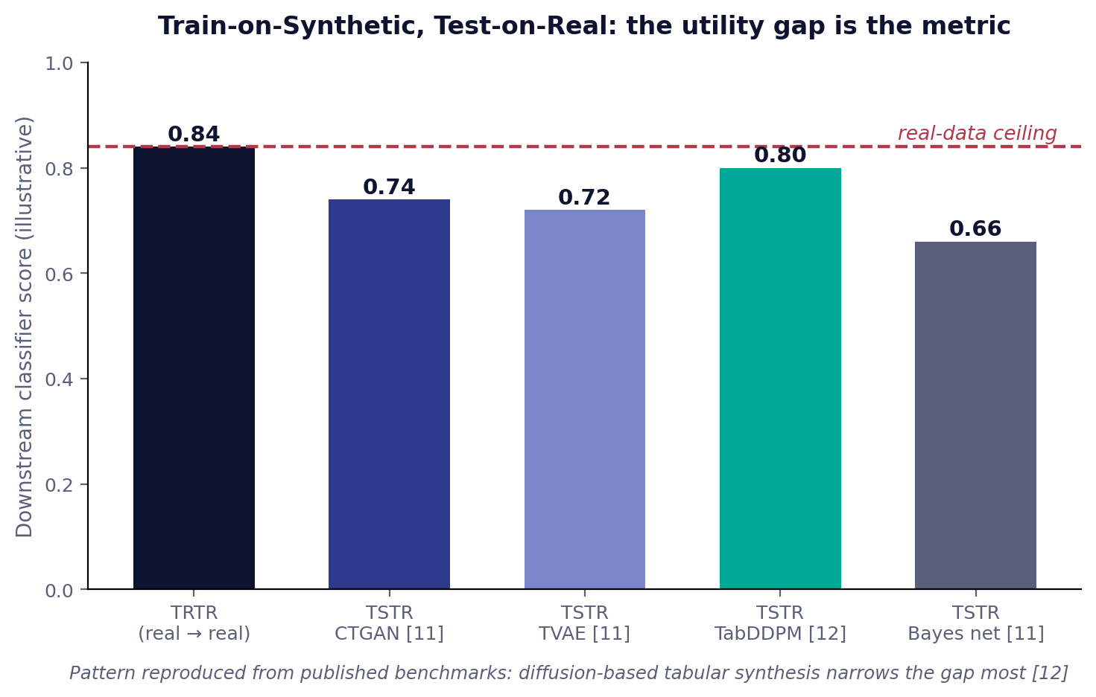
DAY 3 · TOPIC 1
Gate 2 — Utility: does a model trained on it work?
TSTR, the core protocol
Train the downstream model on synthetic data only, then test it on a real hold-out set. Compare against TRTR — the same model trained on real data. The gap is the utility cost [10] [28].
Also run TRTS
Train on real, test on synthetic. A large TRTS gap flags synthetic records that no real-data model recognises [10].
The trap
A near-zero utility gap can mean the generator memorised the training set. Always read utility alongside Gate 3 [27] [30].
Sources: [10] [27] [28] [30]

Slide 52
DAY 3 · TOPIC 1
Fidelity is not enough: coverage and authenticity
Realism (α-precision)
Diversity (β-recall)
Authenticity
Fidelity. What share of the synthetic records look like plausible real ones? [27]
Coverage. How much of the real data's variety does the synthetic data reproduce — did we lose any subpopulations? [27]
Novelty. What share of the synthetic records are genuinely new, rather than copies of training records? [27]
Why this three-way split is the right frame
These are independent axes. A memorising generator scores perfectly on precision and recall while scoring zero on authenticity which is exactly the case that a two-axis metric cannot detect, and exactly the case that leaks [27].
Practical consequence: authenticity is the bridge between the quality gate and the privacy gate — it is a quality metric that measures a privacy property.
Sources: [27]

Slide 53
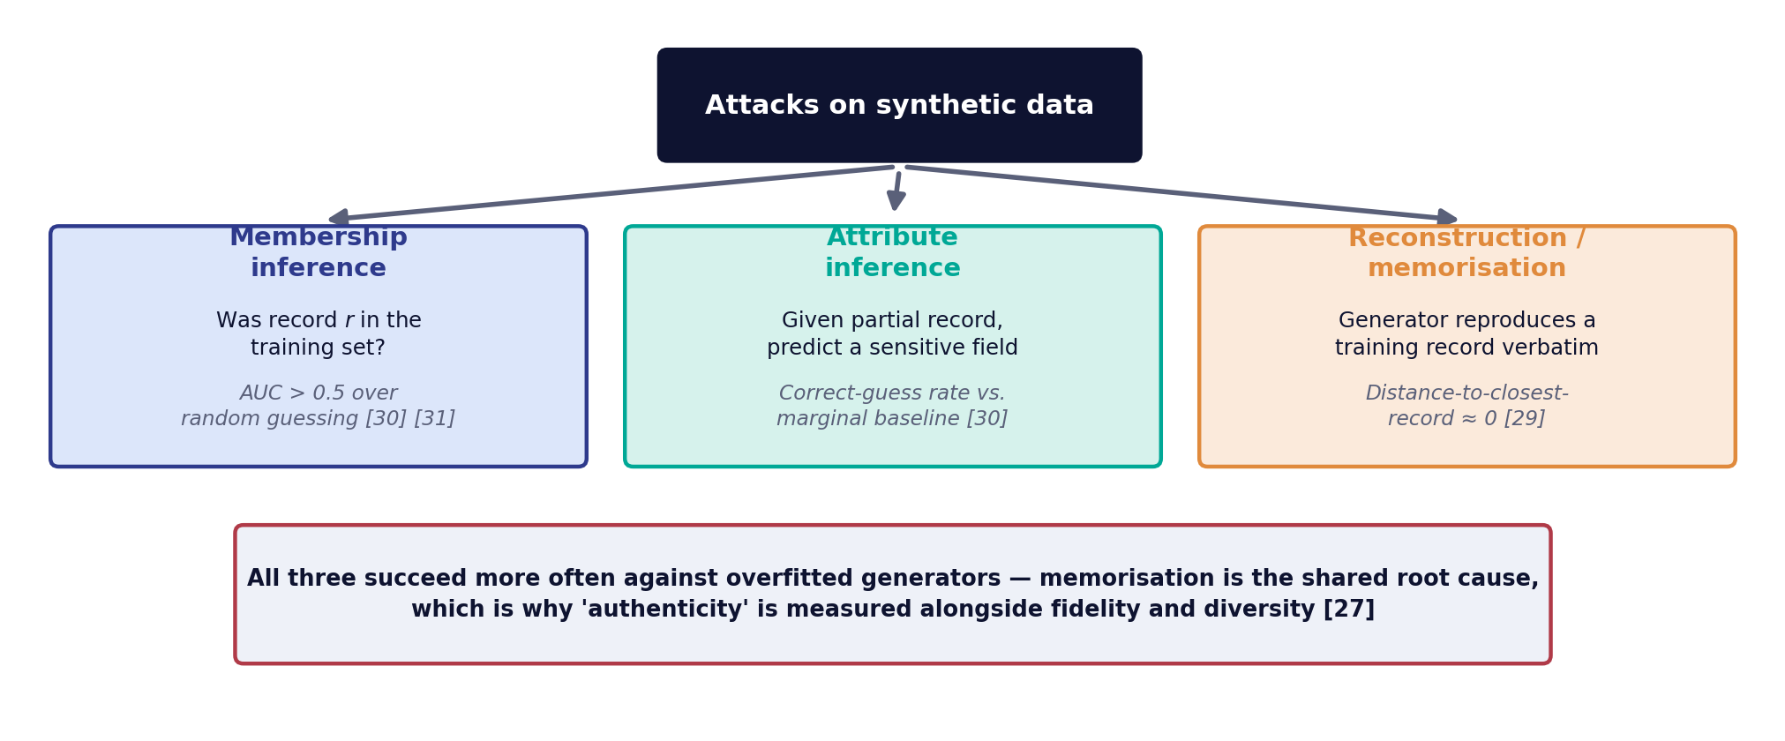
DAY 3 · TOPIC 2
Gate 3 — Privacy: what an attacker actually tries
None of these attacks needs access to the generator. They operate on the released synthetic dataset, which is the threat model that matters for publication [30].
Sources: [27] [29] [30] [31]

Slide 54
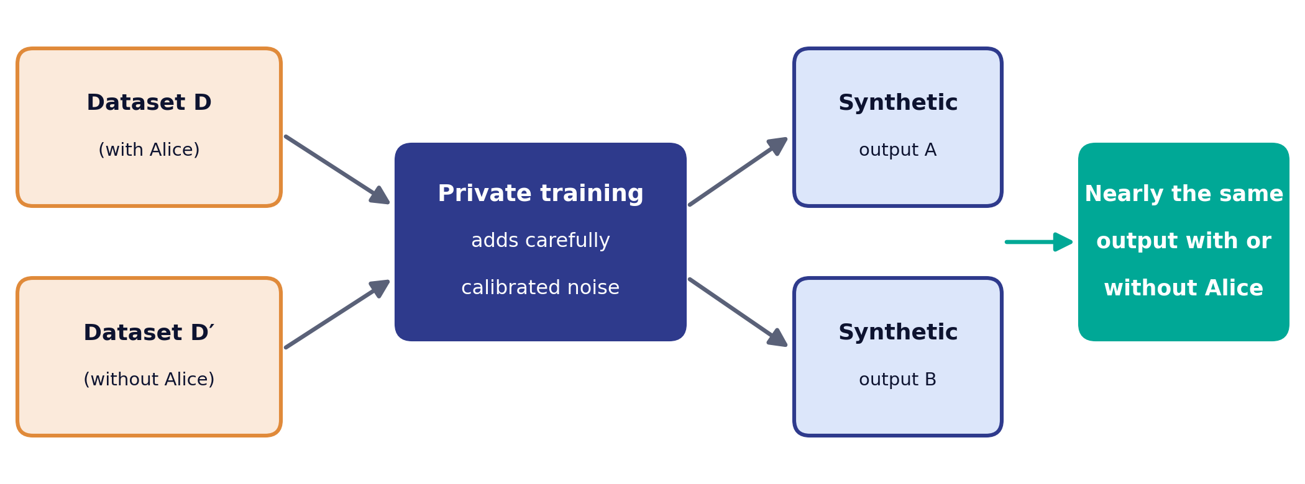
DAY 3 · TOPIC 2
Differential privacy: the only formal guarantee on offer
ε sets how similar the two outputs must be. Smaller ε means stronger protection but more noise, and utility can collapse [25] [26].
In practice: train the generator with a DP mechanism and publish ε with the dataset, so the claimed protection can be checked [24] [25].
Sources: [24] [25] [26]

Slide 55
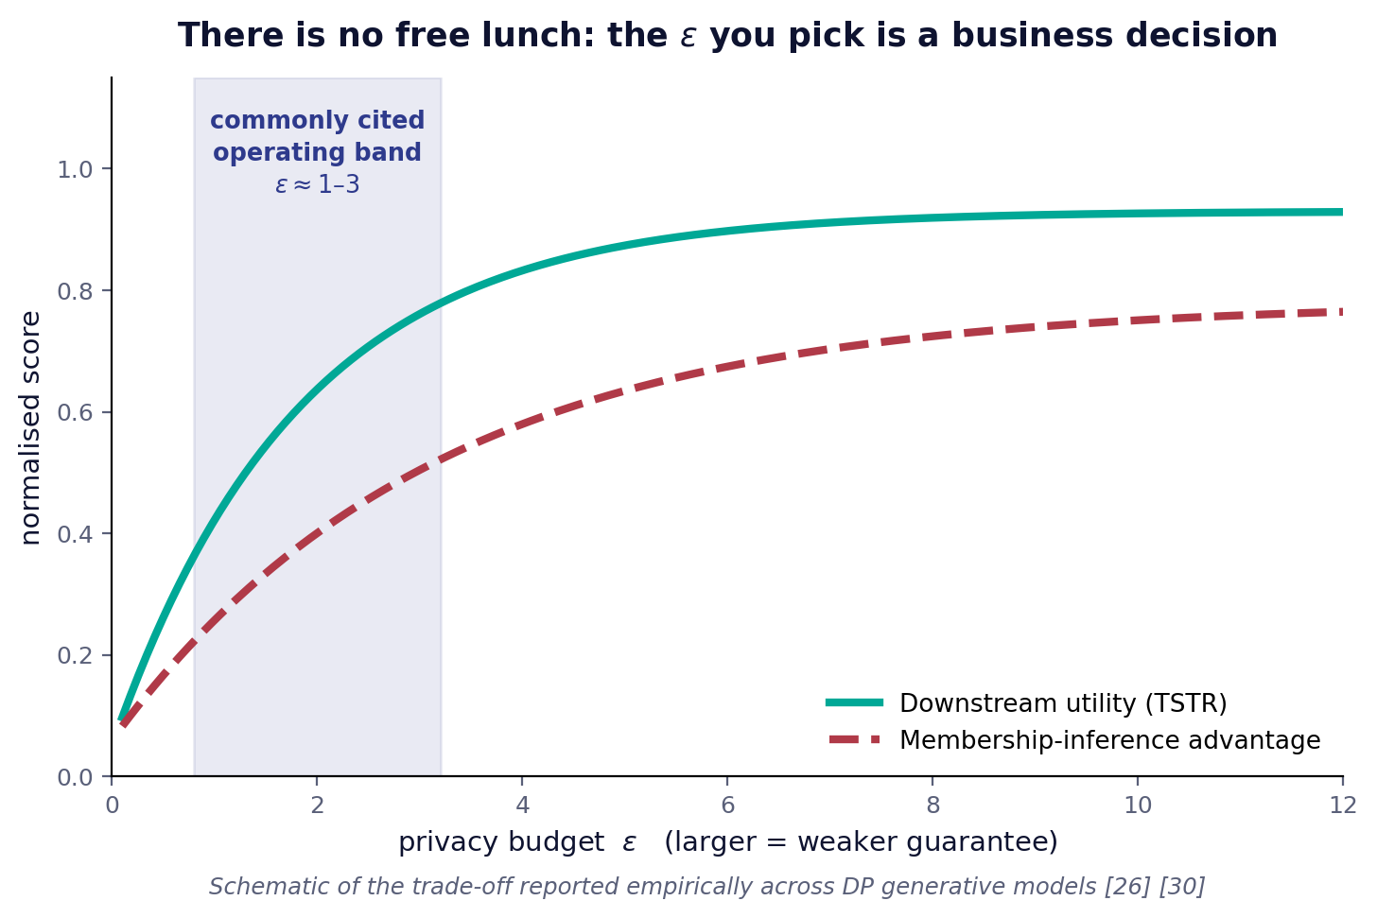
DAY 3 · TOPIC 2
The uncomfortable finding you should know about
The empirical result
A controlled evaluation across a range of generative models found that synthetic data either failed to prevent inference attacks or failed to retain utility — and that the trade-off was hard to predict in advance [30].
What to do about it
Do not claim anonymity. Claim a measured risk reduction, state the ε if you used a DP mechanism, publish the attack results you ran, and re-run them whenever the generator changes [24] [30].
Sources: [24] [26] [30]

Slide 56
DAY 3 · TOPIC 2
A release checklist you can actually use
# | Check | Pass condition
1 | Purpose and audience of the release are documented | A named downstream task exists; utility is measured against it [1]
2 | Generator, version, training data and seed are recorded | The dataset is reproducible and auditable [1]
3 | Fidelity gate run at marginal, joint and sample level | KS, correlation delta and a realism score (α-precision) reported [27] [29]
4 | Utility gate run as TSTR against a real hold-out | Gap to TRTR is within the agreed tolerance [10]
5 | Coverage checked, not just fidelity | A diversity score (β-recall) confirms no subpopulation was dropped [27]
6 | Memorisation checked | Authenticity score and distance to the closest real record reported [27] [29]
7 | Membership inference attack executed | Attacker advantage over random guessing is within tolerance [30] [31]
8 | Privacy budget stated if a DP mechanism was used | ε and δ published alongside the dataset [24] [25]
9 | Business-rule repair rate recorded | Repair rate is low enough that the model, not the patch, is doing the work
10 | Re-evaluation trigger defined | Any change to model, data or schema re-opens all three gates [30]
Sources: [1] [10] [24] [25] [27] [29] [30] [31]

Slide 57
DAY 3 · LEARNING CHECK
Five-minute check: make the call
1
The scorecard
A dataset scores: KS statistic 0.21 (real vs synthetic), TSTR 87% (vs 91% real-on-real), authenticity 0.96.
2
Interpret it
Which gate looks weakest here — fidelity, utility or privacy? Is that gap large enough to worry about on its own?
3
Make the call
Would you release this dataset? Decide, then write the one sentence you would use to defend your decision.
There is rarely one correct answer. What matters is that the decision is traceable to the numbers, not to a gut feeling — which is exactly what today’s scorecard is for.
Discussion — no citations required

Slide 58
DAY 3 · TOPIC 3
An illustrative Stixis-style AI use case: the problem as posed
This is an illustrative scenario, not a real Stixis engagement: the architecture and gates below are a reference pattern assembled from the published results cited throughout, built to show how the three-gate method applies in an industry setting.
The situation
Why one dataset will not serve all three
A regulated customer dataset cannot leave the production boundary. Three teams need it: QA needs realistic volume, data science needs rare-event density, and an external vendor needs a shareable sample.
Each consumer sits at a different point on the fidelity–utility–privacy triangle. The external share needs the strongest guarantee and can tolerate the largest utility loss; QA needs the opposite [27] [30].
3
1
3
consumers, three different privacy postures
generator family, tuned separately per consumer
quality gates applied identically to every release
Sources: [27] [30]

Slide 59
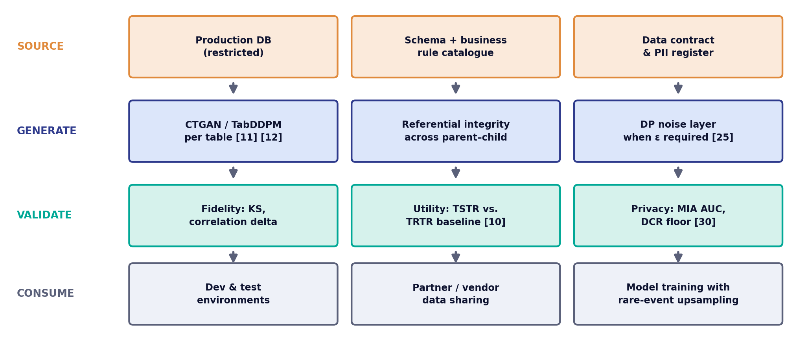
DAY 3 · TOPIC 3
Illustrative reference architecture: source to consumption
The vertical lanes are the four decisions that recur in every engagement: what you model, how you generate, how you prove it, and who consumes it.
Sources: [9] [10] [11] [12] [25] [30]

Slide 60
DAY 3 · TOPIC 3
What the pattern delivers, and what it does not
Consumer | Configuration | Accepted trade
QA / test environments | TabDDPM without a DP mechanism, inside the trust boundary; full schema and referential integrity [9] [12] | Highest fidelity, weakest formal guarantee — acceptable because the data never leaves
Internal model training | CTGAN with conditional oversampling of the rare class, mixed with real majority data [11] | Hybrid release; rare-event recall improves, the real subset carries its own risk
External vendor share | DP-trained generator with a published ε, plus a membership-inference audit before release [25] [26] [30] | Measurable utility loss accepted in exchange for a stated bound
1
Gate before you scale
2
Version the generator, not just the data
3
Say 'risk-reduced', not 'anonymous'
Running the three gates on a small pilot costs a day. Discovering a coverage failure after a team has built on the data costs a quarter [27].
Every regenerated dataset is a new dataset with new risk. Tie the audit to the generator version [30].
The literature does not support the stronger claim, and the stronger claim is the one that creates liability [30].
Sources: [9] [11] [12] [25] [26] [27] [30]

Slide 61
DAY 3 · LAB
Hands-on: read the scorecard, make the call
1
Start from pre-generated data — You are given four ready-made datasets — real hold-out, CTGAN, TVAE and a DP-protected version — with their fidelity, utility and privacy scores already computed. No training today [10].
2
Read the fidelity and utility numbers — Given KS statistics, correlation deltas and TSTR scores for each dataset, decide which one is statistically closest to real and which would train the most useful model [10] [27].
3
Read the privacy numbers — Given realism, diversity and authenticity scores and a pre-computed membership inference advantage for each dataset, decide which one is safest to release [27] [30] [31].
4
Instructor demo — Watch the instructor retrain a generator under DP at two different ε values, re-run all three gates live, and plot the utility loss against ε [25] [26].
5
Make a release decision — Using only your scorecard, answer: would you release this dataset? Choose one and write two sentences justifying it.
Sources: [10] [25] [26] [27] [30] [31]

Slide 62
COURSE CLOSE
Five things to take back to your work
1
Start from the consumer. The downstream purpose sets the utility bar, and the utility bar sets the model — never the other way round [1] [27].
2
Measure the joint, not just the marginals. Matching every column separately is the most common way to ship a useless dataset [9] [29].
3
Coverage failures are silent. Without a diversity check (β-recall) you will not notice that a subpopulation vanished [27].
4
Privacy is a measured property, not a label. Run the attack, report the number, state the ε [24] [30].
5
Re-audit on every regeneration. A new sample from a retrained generator is a new release with new risk [30].
Stixis AI Solutions Private Limited · HSR Layout, Bengaluru

Slide 63
APPENDIX
Advanced / Optional Material
Instructor reference for stronger cohorts and follow-up questions. Not part of the core three-day flow.
1
2
3
4
5
6
Model taxonomy
Tabular & text detail
GAN theory
VAE & diffusion maths
Metric definitions
Privacy mechanics
13 optional slides · Day 1 · Day 2 · Day 3

Slide 64
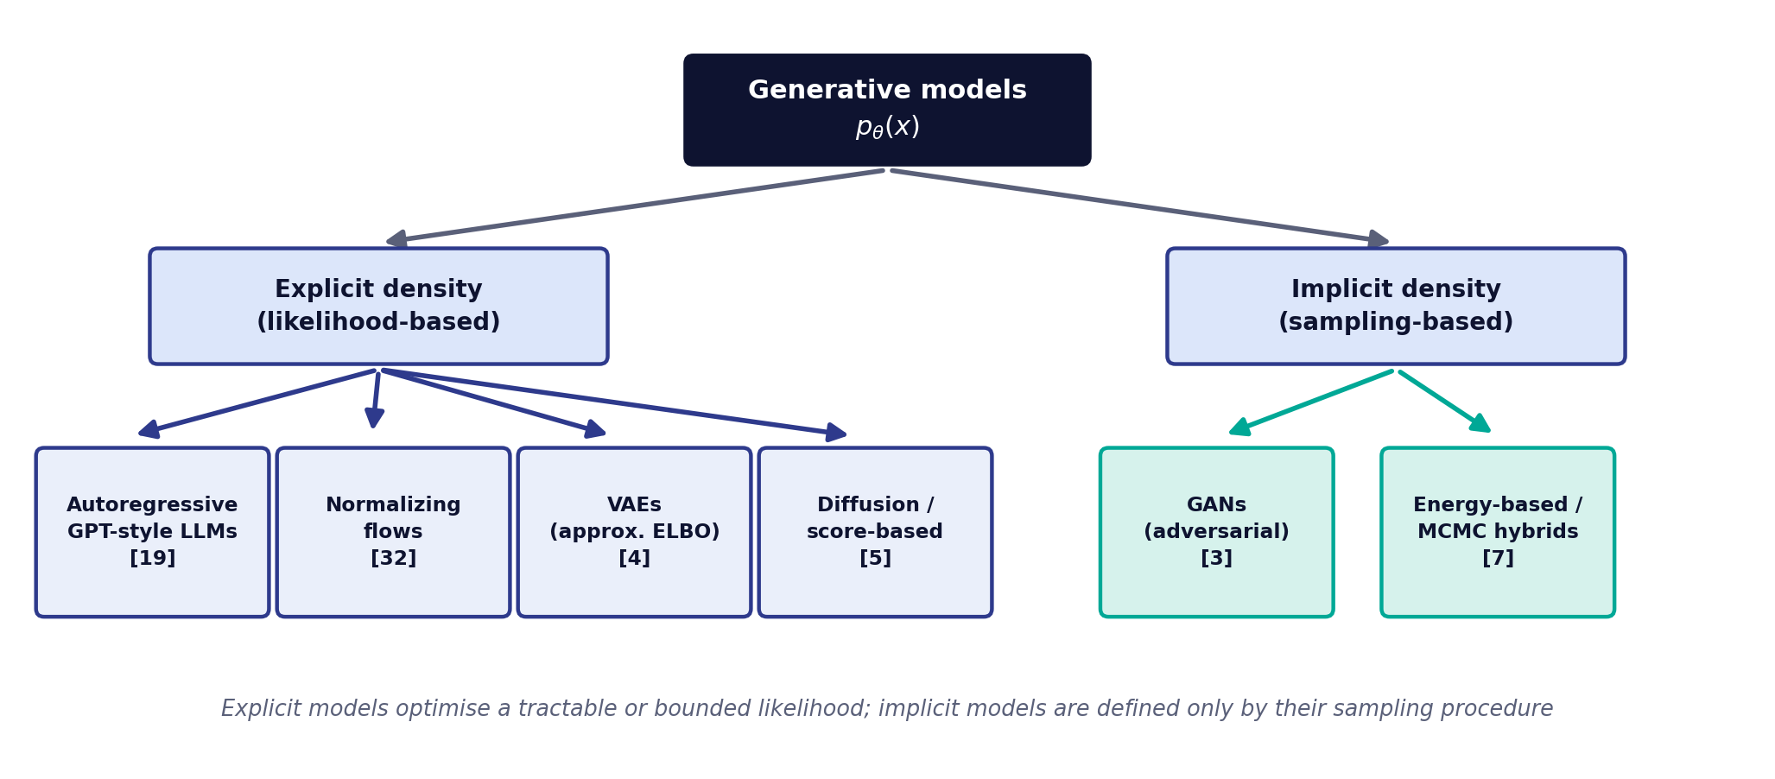
ADVANCED · DAY 1 · TOPIC 7
A map of the generative model families
The split that matters operationally: explicit-density models give you a likelihood to evaluate and audit; implicit models give you samples and nothing else [7] [27].
Sources: [3] [4] [5] [7] [19] [32]

Slide 65
ADVANCED · DAY 2 · TOPIC 1
The current tabular toolbox
Method | Mechanism | Reported strength | Watch out for
CTGAN | Conditional GAN with mode-specific normalisation and training-by-sampling [11] | Strong on imbalanced categoricals; the de facto baseline [11] | Adversarial instability; needs careful epoch selection
TVAE | Variational autoencoder over the same tabular encoding [11] | More stable to train than CTGAN; competitive on several benchmarks [11] | Tends to over-smooth continuous columns
TabDDPM | Multinomial diffusion for categoricals plus Gaussian diffusion for continuous columns [12] | Outperforms GAN and VAE alternatives across a wide benchmark suite [12] | Slow sampling; higher training cost
GReaT (LLM) | Serialise each row to text and fine-tune an autoregressive language model [13] | Exploits column-name semantics; supports arbitrary conditioning [13] | Sequential sampling; numeric precision loss
PrivBayes | Differentially private Bayesian network over low-dimensional marginals [47] | Formal ε guarantee with interpretable structure [47] | Limited capacity for high-order interactions
SDV | Recursive modelling of a relational schema, table by table [9] | Preserves foreign keys across a multi-table database [9] | Per-table fidelity bounded by the underlying model
Sources: [9] [11] [12] [13] [47]

Slide 66
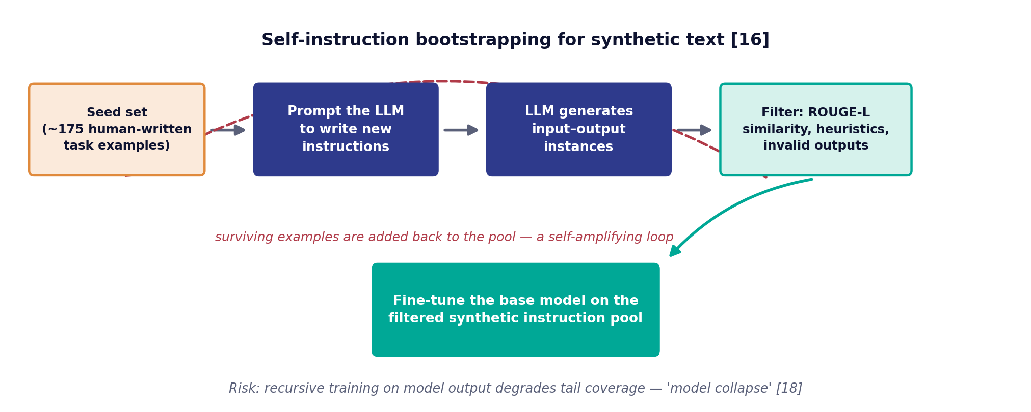
ADVANCED · DAY 2 · TOPIC 2
The self-instruction loop, and its failure mode
What it buys
What it costs
Instruction data generated by the model itself substantially improves instruction-following, at a fraction of human annotation cost [16].
Training generation after generation on model output degrades the tails first — distribution collapse is empirically demonstrated [18].
Sources: [16] [18]

Slide 67
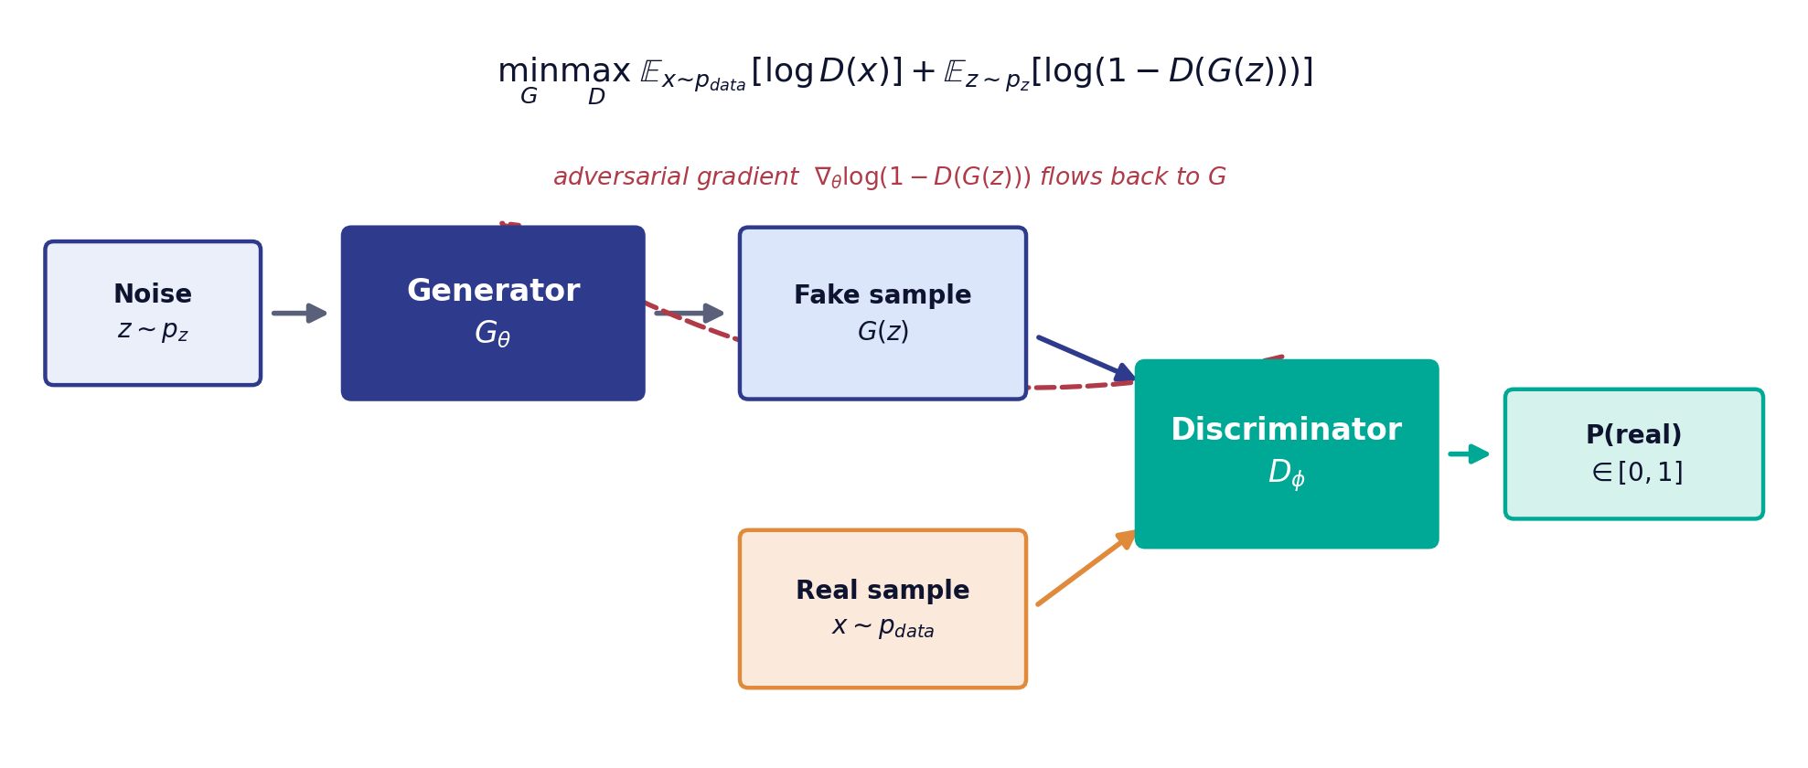
ADVANCED · DAY 2 · TOPIC 4
GANs: the adversarial game in full
At the theoretical optimum the discriminator cannot distinguish the two distributions, which corresponds to minimising the Jensen–Shannon divergence between them [3].
Sources: [3]

Slide 68
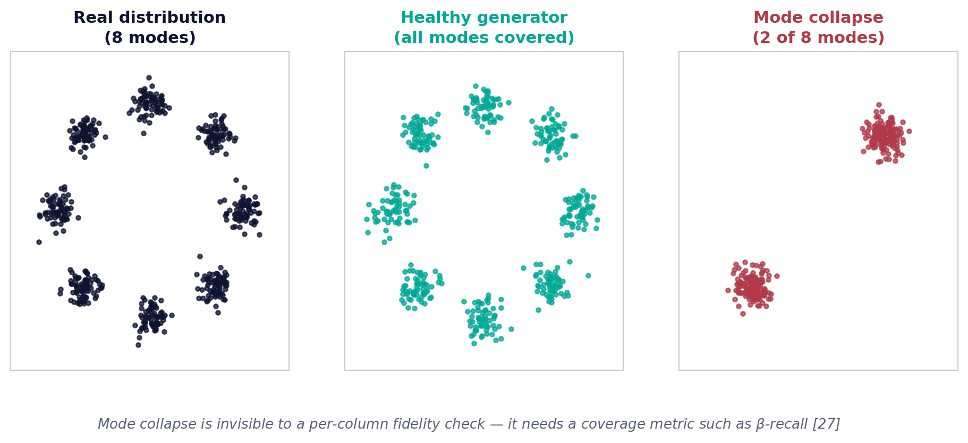
ADVANCED · DAY 2 · TOPIC 4
Why GAN training misbehaves
Vanishing gradients
Mode collapse
Non-convergence
When the discriminator becomes too strong, its output saturates and the generator receives almost no gradient. The original paper's non-saturating loss is the first fix [3].
The generator finds one output the discriminator cannot reject and produces variations of it forever. Diversity dies while the loss looks healthy [41].
Two networks optimising opposing objectives can cycle indefinitely rather than settle. Loss curves are not a reliable stopping signal [35].
Sources: [3] [35] [41]

Slide 69
ADVANCED · DAY 2 · LEARNING CHECK
Five-minute check: think it through
1
The question
If the Discriminator becomes extremely good, extremely quickly, what happens to the signal the Generator receives?
2
Work it through
A near-perfect Discriminator rejects almost everything the Generator produces. Think about what that does to the gradient the Generator trains on.
3
Connect it back
Which failure mode from the previous slide does this describe? What does the practical fix look like?
This is the vanishing-gradient problem in GAN training — one reason practitioners watch the loss curves so closely, rather than trusting the objective alone.
Discussion — no citations required

Slide 70
ADVANCED · DAY 2 · TOPIC 4
The variants you will actually use
Variant | What it changes | Why it helps
Conditional GAN [37] | Feeds a class label to both generator and discriminator | Lets you generate a chosen class on demand — the basis of rare-event oversampling
Wasserstein GAN [35] | Replaces the JS objective with an Earth-Mover distance and a critic | Gives a loss that correlates with sample quality and reduces mode collapse [35]
WGAN-GP [36] | Enforces the Lipschitz constraint with a gradient penalty instead of weight clipping | Markedly more stable training across architectures [36]
StyleGAN [20] | Style-based generator with per-layer latent modulation | State-of-the-art image fidelity plus disentangled, controllable attributes [20]
CTGAN [11] | Conditional vector over discrete columns plus mode-specific normalisation | Makes the family usable on real tabular data at all [11]
PATE-GAN [26] | Trains the discriminator through a differentially private teacher ensemble | Adds a formal ε guarantee to the generated output [26]
Sources: [11] [20] [26] [35] [36] [37]

Slide 71
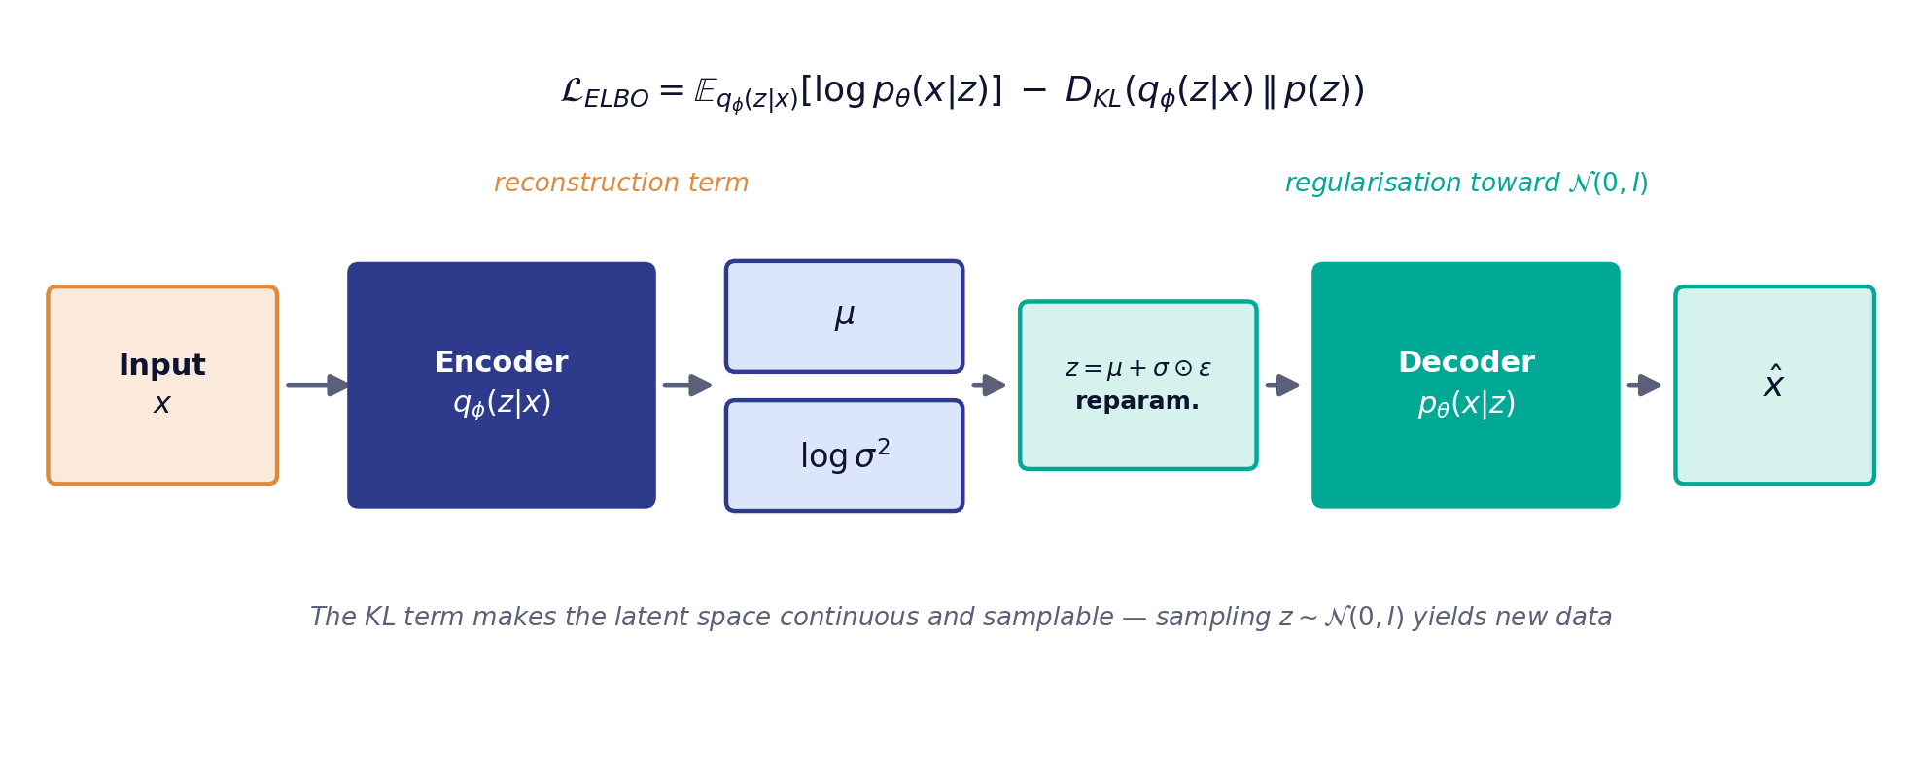
ADVANCED · DAY 2 · TOPIC 5
VAEs: encode, regularise, decode
The reparameterisation trick is the whole enabling idea: writing z = μ + σ ⊙ ε moves the randomness out of the computational path so gradients can flow through the encoder [4].
Sources: [4]

Slide 72
ADVANCED · DAY 2 · TOPIC 5
What the ELBO buys you, and what it costs
Advantages
Limitations
Stable, non-adversarial training. A principled bound on the log-likelihood that can be reported and compared. A continuous latent space that supports interpolation, conditioning and anomaly scoring [4] [7].
The reconstruction term under a Gaussian likelihood averages over plausible outputs, which produces blurred images and over-smoothed numeric columns. Posterior collapse can leave latent dimensions unused [7] [38].
Variant | Modification | Use case
β-VAE [38] | Up-weights the KL term by a factor β | Disentangled latent factors at some cost in reconstruction quality [38]
Conditional VAE | Conditions encoder and decoder on a label | Generating a specified class — the VAE analogue of a conditional GAN
VQ-VAE [39] | Quantises the latent space into a discrete codebook | Avoids posterior collapse; pairs well with autoregressive priors [39]
TVAE [11] | Tabular encoding with mode-specific normalisation | Frequently matches or beats CTGAN with far less tuning [11]
Sources: [4] [7] [11] [38] [39]

Slide 73
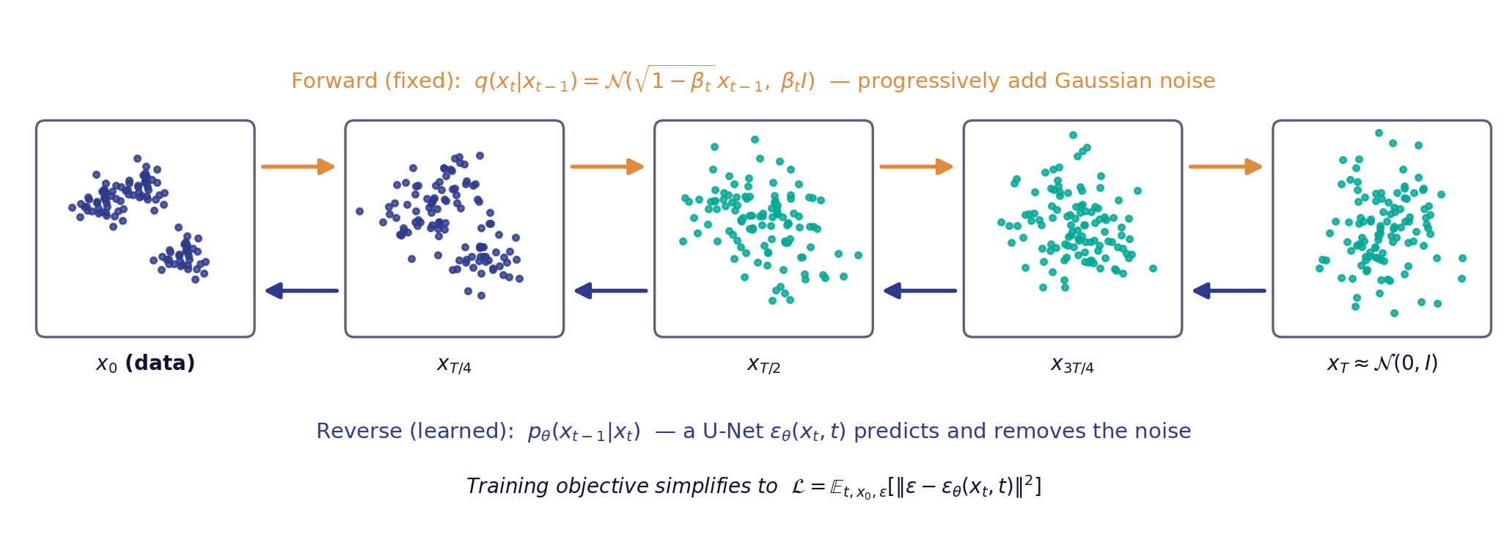
ADVANCED · DAY 2 · TOPIC 6
Diffusion models: destroy, then learn to rebuild
The forward process has no learned parameters at all. All of the model capacity goes into a single network that predicts the noise added at an arbitrary step t [5] [6].
Sources: [5] [6]

Slide 74
ADVANCED · DAY 2 · TOPIC 6
Conditioning, guidance and the cost of sampling
1
Conditioning
Feed a class label, a text embedding or a partial record into the denoiser at every step, so the reverse process is steered toward a target [8] [40].
2
Classifier-free guidance
Train one network both with and without the condition, then extrapolate between the two predictions at sampling time. Trades diversity for fidelity via a single scalar [40].
3
Latent diffusion
Run the whole diffusion process in a compressed autoencoder latent space rather than pixel space, cutting compute by orders of magnitude while keeping quality [8].
4
Sampling cost
Sampling requires many sequential network evaluations — the main practical drawback against GANs, and the reason the trilemma bites [5] [33].
For tabular synthesis, TabDDPM applies Gaussian diffusion to numeric columns and multinomial diffusion to categorical ones, and reports superiority over GAN and VAE alternatives across benchmarks [12].
Sources: [5] [8] [12] [33] [40]

Slide 75
ADVANCED · DAY 3 · TOPIC 1
Fidelity is not enough: coverage and authenticity
α-Precision
β-Recall
Authenticity
Fidelity. The fraction of synthetic samples that fall inside the α-support of the real distribution — are they realistic? [27]
Diversity. The fraction of the real distribution the synthetic data actually covers — did we lose subpopulations? [27]
Generalisation. The share of synthetic samples that are genuinely new rather than copied from training data [27]
Why this three-way split is the right frame
These are independent axes. A memorising generator scores perfectly on precision and recall while scoring zero on authenticity — which is exactly the case that a two-axis metric cannot detect, and exactly the case that leaks [27].
Practical consequence: authenticity is the bridge between the quality gate and the privacy gate — it is a quality metric that measures a privacy property.
Sources: [27]

Slide 76
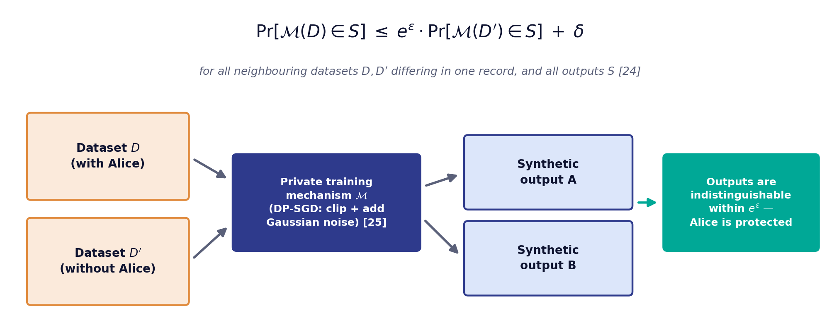
ADVANCED · DAY 3 · TOPIC 2
Differential privacy: the only formal guarantee on offer
DP-SGD reaches this bound by clipping per-example gradients and adding calibrated Gaussian noise during training [25].
PATE-GAN instead trains the discriminator through a differentially private teacher ensemble, preserving the ε bound end to end [26].
Sources: [24] [25] [26]

Slide 77
REFERENCES · APA 7TH EDITION
Reference list (1 of 6)
[1]
Jordon, J., Szpruch, L., Houssiau, F., Bottarelli, M., Cherubin, G., Maple, C., Cohen, S. N., & Weller, A. (2022). Synthetic data — what, why and how? arXiv. https://arxiv.org/abs/2205.03257
[2]
Figueira, A., & Vaz, B. (2022). Survey on synthetic data generation, evaluation methods and GANs. Mathematics, 10(15), 2733. https://doi.org/10.3390/math10152733
[3]
Goodfellow, I., Pouget-Abadie, J., Mirza, M., Xu, B., Warde-Farley, D., Ozair, S., Courville, A., & Bengio, Y. (2014). Generative adversarial nets. Advances in Neural Information Processing Systems, 27, 2672–2680.
[4]
Kingma, D. P., & Welling, M. (2014). Auto-encoding variational Bayes. Proceedings of the 2nd International Conference on Learning Representations (ICLR).
[5]
Ho, J., Jain, A., & Abbeel, P. (2020). Denoising diffusion probabilistic models. Advances in Neural Information Processing Systems, 33, 6840–6851.
[6]
Sohl-Dickstein, J., Weiss, E. A., Maheswaranathan, N., & Ganguli, S. (2015). Deep unsupervised learning using nonequilibrium thermodynamics. Proceedings of the 32nd International Conference on Machine Learning, PMLR 37, 2256–2265.
[7]
Bond-Taylor, S., Leach, A., Long, Y., & Willcocks, C. G. (2022). Deep generative modelling: A comparative review of VAEs, GANs, normalizing flows, energy-based and autoregressive models. IEEE Transactions on Pattern Analysis and Machine Intelligence, 44(11), 7327–7347. https://doi.org/10.1109/TPAMI.2021.3116668
[8]
Rombach, R., Blattmann, A., Lorenz, D., Esser, P., & Ommer, B. (2022). High-resolution image synthesis with latent diffusion models. Proceedings of the IEEE/CVF Conference on Computer Vision and Pattern Recognition (CVPR), 10684–10695.
[9]
Patki, N., Wedge, R., & Veeramachaneni, K. (2016). The Synthetic Data Vault. Proceedings of the IEEE International Conference on Data Science and Advanced Analytics (DSAA), 399–410. https://doi.org/10.1109/DSAA.2016.49

Slide 78
REFERENCES · APA 7TH EDITION
Reference list (2 of 6)
[10]
Esteban, C., Hyland, S. L., & Rätsch, G. (2017). Real-valued (medical) time series generation with recurrent conditional GANs. arXiv. https://arxiv.org/abs/1706.02633
[11]
Xu, L., Skoularidou, M., Cuesta-Infante, A., & Veeramachaneni, K. (2019). Modeling tabular data using conditional GAN. Advances in Neural Information Processing Systems, 32, 7335–7345.
[12]
Kotelnikov, A., Baranchuk, D., Rubachev, I., & Babenko, A. (2023). TabDDPM: Modelling tabular data with diffusion models. Proceedings of the 40th International Conference on Machine Learning, PMLR 202, 17564–17579.
[13]
Borisov, V., Seßler, K., Leemann, T., Pawelczyk, M., & Kasneci, G. (2023). Language models are realistic tabular data generators. Proceedings of the 11th International Conference on Learning Representations (ICLR).
[14]
Wei, J., & Zou, K. (2019). EDA: Easy data augmentation techniques for boosting performance on text classification tasks. Proceedings of EMNLP-IJCNLP 2019, 6382–6388.
[15]
Sennrich, R., Haddow, B., & Birch, A. (2016). Improving neural machine translation models with monolingual data. Proceedings of the 54th Annual Meeting of the Association for Computational Linguistics, 86–96.
[16]
Wang, Y., Kordi, Y., Mishra, S., Liu, A., Smith, N. A., Khashabi, D., & Hajishirzi, H. (2023). Self-Instruct: Aligning language models with self-generated instructions. Proceedings of the 61st Annual Meeting of the Association for Computational Linguistics, 13484–13508.
[17]
Gunasekar, S., Zhang, Y., Aneja, J., Mendes, C. C. T., Del Giorno, A., Gopi, S., Javaheripi, M., Kauffmann, P., de Rosa, G., Saarikivi, O., Salim, A., Shah, S., Behl, H. S., Wang, X., Bubeck, S., Eldan, R., Kalai, A. T., Lee, Y. T., & Li, Y. (2023). Textbooks are all you need. arXiv. https://arxiv.org/abs/2306.11644
[18]
Shumailov, I., Shumaylov, Z., Zhao, Y., Papernot, N., Anderson, R., & Gal, Y. (2024). AI models collapse when trained on recursively generated data. Nature, 631, 755–759. https://doi.org/10.1038/s41586-024-07566-y

Slide 79
REFERENCES · APA 7TH EDITION
Reference list (3 of 6)
[19]
Brown, T. B., Mann, B., Ryder, N., Subbiah, M., Kaplan, J., Dhariwal, P., Neelakantan, A., Shyam, P., Sastry, G., Askell, A., … Amodei, D. (2020). Language models are few-shot learners. Advances in Neural Information Processing Systems, 33, 1877–1901.
[20]
Karras, T., Laine, S., & Aila, T. (2019). A style-based generator architecture for generative adversarial networks. Proceedings of the IEEE/CVF Conference on Computer Vision and Pattern Recognition (CVPR), 4401–4410.
[21]
Richter, S. R., Vineet, V., Roth, S., & Koltun, V. (2016). Playing for data: Ground truth from computer games. Proceedings of the European Conference on Computer Vision (ECCV), 102–118.
[22]
Tremblay, J., Prakash, A., Acuna, D., Brophy, M., Jampani, V., Anil, C., To, T., Cameracci, E., Boochoon, S., & Birchfield, S. (2018). Training deep networks with synthetic data: Bridging the reality gap by domain randomization. Proceedings of the IEEE/CVF CVPR Workshops, 969–977.
[23]
Ros, G., Sellart, L., Materzynska, J., Vazquez, D., & Lopez, A. M. (2016). The SYNTHIA dataset: A large collection of synthetic images for semantic segmentation of urban scenes. Proceedings of the IEEE Conference on Computer Vision and Pattern Recognition (CVPR), 3234–3243.
[24]
Dwork, C., McSherry, F., Nissim, K., & Smith, A. (2006). Calibrating noise to sensitivity in private data analysis. Proceedings of the Third Theory of Cryptography Conference (TCC), 265–284.
[25]
Abadi, M., Chu, A., Goodfellow, I., McMahan, H. B., Mironov, I., Talwar, K., & Zhang, L. (2016). Deep learning with differential privacy. Proceedings of the 2016 ACM SIGSAC Conference on Computer and Communications Security (CCS), 308–318.
[26]
Jordon, J., Yoon, J., & van der Schaar, M. (2019). PATE-GAN: Generating synthetic data with differential privacy guarantees. Proceedings of the 7th International Conference on Learning Representations (ICLR).
[27]
Alaa, A., van Breugel, B., Saveliev, E. S., & van der Schaar, M. (2022). How faithful is your synthetic data? Sample-level metrics for evaluating and auditing generative models. Proceedings of the 39th International Conference on Machine Learning, PMLR 162, 290–306.

Slide 80
REFERENCES · APA 7TH EDITION
Reference list (4 of 6)
[28]
Choi, E., Biswal, S., Malin, B., Duke, J., Stewart, W. F., & Sun, J. (2017). Generating multi-label discrete patient records using generative adversarial networks. Proceedings of the 2nd Machine Learning for Healthcare Conference, PMLR 68, 286–305.
[29]
Yale, A., Dash, S., Dutta, R., Guyon, I., Pavao, A., & Bennett, K. P. (2020). Generation and evaluation of privacy preserving synthetic health data. Neurocomputing, 416, 244–255. https://doi.org/10.1016/j.neucom.2019.12.136
[30]
Stadler, T., Oprisanu, B., & Troncoso, C. (2022). Synthetic data — anonymisation groundhog day. Proceedings of the 31st USENIX Security Symposium, 1451–1468.
[31]
Shokri, R., Stronati, M., Song, C., & Shmatikov, V. (2017). Membership inference attacks against machine learning models. Proceedings of the 2017 IEEE Symposium on Security and Privacy, 3–18.
[32]
Papamakarios, G., Nalisnick, E., Rezende, D. J., Mohamed, S., & Lakshminarayanan, B. (2021). Normalizing flows for probabilistic modeling and inference. Journal of Machine Learning Research, 22(57), 1–64.
[33]
Dhariwal, P., & Nichol, A. (2021). Diffusion models beat GANs on image synthesis. Advances in Neural Information Processing Systems, 34, 8780–8794.
[34]
Vaswani, A., Shazeer, N., Parmar, N., Uszkoreit, J., Jones, L., Gomez, A. N., Kaiser, Ł., & Polosukhin, I. (2017). Attention is all you need. Advances in Neural Information Processing Systems, 30, 5998–6008.
[35]
Arjovsky, M., Chintala, S., & Bottou, L. (2017). Wasserstein generative adversarial networks. Proceedings of the 34th International Conference on Machine Learning, PMLR 70, 214–223.
[36]
Gulrajani, I., Ahmed, F., Arjovsky, M., Dumoulin, V., & Courville, A. (2017). Improved training of Wasserstein GANs. Advances in Neural Information Processing Systems, 30, 5767–5777.

Slide 81
REFERENCES · APA 7TH EDITION
Reference list (5 of 6)
[37]
Mirza, M., & Osindero, S. (2014). Conditional generative adversarial nets. arXiv. https://arxiv.org/abs/1411.1784
[38]
Higgins, I., Matthey, L., Pal, A., Burgess, C., Glorot, X., Botvinick, M., Mohamed, S., & Lerchner, A. (2017). β-VAE: Learning basic visual concepts with a constrained variational framework. Proceedings of the 5th International Conference on Learning Representations (ICLR).
[39]
van den Oord, A., Vinyals, O., & Kavukcuoglu, K. (2017). Neural discrete representation learning. Advances in Neural Information Processing Systems, 30, 6306–6315.
[40]
Ho, J., & Salimans, T. (2022). Classifier-free diffusion guidance. arXiv. https://arxiv.org/abs/2207.12598
[41]
Salimans, T., Goodfellow, I., Zaremba, W., Cheung, V., Radford, A., & Chen, X. (2016). Improved techniques for training GANs. Advances in Neural Information Processing Systems, 29, 2234–2242.
[42]
Heusel, M., Ramsauer, H., Unterthiner, T., Nessler, B., & Hochreiter, S. (2017). GANs trained by a two time-scale update rule converge to a local Nash equilibrium. Advances in Neural Information Processing Systems, 30, 6626–6637.
[43]
Nikolenko, S. I. (2021). Synthetic data for deep learning. Springer. https://doi.org/10.1007/978-3-030-75178-4
[44]
Hernandez, M., Epelde, G., Alberdi, A., Cilla, R., & Rankin, D. (2022). Synthetic data generation for tabular health records: A systematic review. Neurocomputing, 493, 28–45. https://doi.org/10.1016/j.neucom.2022.04.053
[45]
Xu, L., & Veeramachaneni, K. (2018). Synthesizing tabular data using generative adversarial networks. arXiv. https://arxiv.org/abs/1811.11264

Slide 82
REFERENCES · APA 7TH EDITION
Reference list (6 of 6)
[46]
Assefa, S. A., Dervovic, D., Mahfouz, M., Tillman, R. E., Reddy, P., & Veloso, M. (2020). Generating synthetic data in finance: Opportunities, challenges and pitfalls. Proceedings of the First ACM International Conference on AI in Finance (ICAIF), 1–8.
[47]
Zhang, J., Cormode, G., Procopiuc, C. M., Srivastava, D., & Xiao, X. (2017). PrivBayes: Private data release via Bayesian networks. ACM Transactions on Database Systems, 42(4), Article 25.

Slide 83

Thank you
Synthetic Data Generation using Generative AI · 3-Day Intensive Course
Stixis AI Solutions Private Limited
477, Urban Vault, 18th Cross Road,
Parangipalya, Sector-2,
HSR Layout, Bangalore-560102.
KARNATAKA, INDIA

